Slide 1

Managing an ELC Setting
Part 1
Early Years Education Support Officers

Slide 2
Aim of the sessions:
To develop your understanding of your role and responsibilities as a manager of an ELC setting.

Slide 3
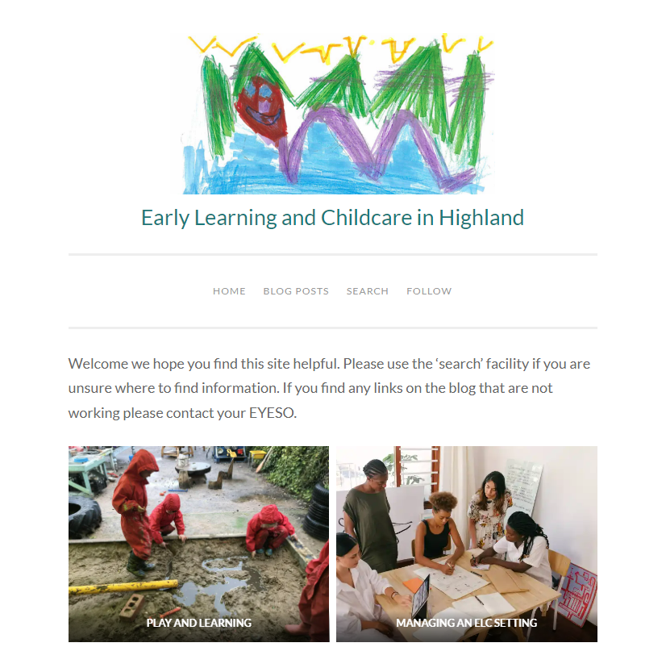
ELC Highland Blog
A one stop shop for all ELC related local and national information.
www.elchighland.com
Most information in the presentation can be found on the blog.
Sign up for blog alerts using the ‘follow’ tab at the top of the home page.

Slide 4
ELC Area Teams Area Team Remits
 | North | West | Mid | South
Early Years Support Officer (EYESO) | Maria Aitken maria.aitken@highland.gov.uk | Jennie Drummond jennie.drummond@highland.gov.uk | Mairi Mackay mairi.mackay2@highland.gov.uk | Ashley Bartlett ashley.bartlett@highland.gov.uk Clare Blair clare.blair@highland.gov.uk Ruth MacLean ruth.macLean2@highland.gov.uk
ELC Commissioner (ELC COMM) | Caroline Green caroline.green@highland.gov.uk | Tracy McIlvar tracy.mcilvar@highland.gov.uk | Jenny Stark jenny.stark@highland.gov.uk | Liz Scott liz.scott2@highland.gov.uk
Early Years Officer (EYO) | Laura Millar laura.miller3@highland.gov.uk | Marion MacSween marion.macsween@highland.gov.uk | Karen Urquhart karen.urquhart@highland.gov.uk | Loraine Knight loraine.knight@highland.gov.uk
Childcare Manager (CCM) | Marea Burnett marea.burnett@highland.gov.uk Carla Gallon carla.gallon@highland.gov.uk | Carole Graham carole.graham@highland.gov.uk | Gillian Semple gillian.semple@highland.gov.uk | Lisa Stuart lisa.stuart1@highland.gov.uk Kolette Urquhart kolette.fraser@highland.gov.uk Ailsa Sugden ailsa.sugden@highland.gov.uk Morven McDiarmid morven.macDiarmid@highland.gov.uk

Slide 5

Realising the Ambition

Slide 6

The
National
Standard

Slide 7
The National Standard 10 criteria
Staffing, leadership & management
Development of children’s cognitive skills, health & wellbeing
Physical environment
Self-evaluation & improvement
Parent & carer engagement & involvement in the life of the setting
Inclusion
Business sustainability
Fair work practices including payment of the living wage
Payment processes
Food
https://elchighland.com/the-national-standard/

Slide 8


Inspections in ELC settings
Who inspects: Education Scotland and the Care Inspectorate
They can inspect jointly or separately
Further information regarding Care Inspectorate and Education Scotland inspections can be found here:
How we inspect regulated services; guidance for providers of regulated care settings and the public
Our approach to scrutiny and improvement
Education Scotland Guidance for ELC Settings/
New Quality Improvement Framework Engagement Sessions

Slide 9
Education Scotland
How good is our early learning and childcare?
Quality Indicators:
1.3 Leadership of change
2.3 Learning, teaching and assessment
3.1 Ensuring wellbeing, equality and inclusion
3.2 Securing children’s progress
2.1 Safeguarding
2.2 Curriculum; learning and developmental pathways
2.7 Partnerships; Impact on children and families

Slide 10
Care Inspectorate
A quality framework for daycare of children, childminding and school-aged childcare
Key questions 1: How good is our care, play and learning?
QI 1.1 Nurturing care and support
QI 1.3 Play and learning
Key question 2: How good is our setting?
QI 2.2 Children experience high quality facilities
Key question 3: How good is our leadership?
QI 3.1 Quality assurance and improvement are led well
Key question 4: How good is our staff team?
QI 4.3 Staff deployment

Slide 11
Collaborative Framework to Support Self-improving Schools and ELC Settings
The Curriculum and Collaborative Improvement Team and Early Years Education Support Officers within our Education & Learning Service seek to work in partnership with schools and ELC settings to provide universal, focused or intensive (UFI) support categories.
How are these categories identified and what might this look like?
Continuous Improvement: ‘improving how we improve’

Slide 12
ELC
Management
Time
Proportionate to the number of children in the setting
Can be delegated
Ringfence
Be visible
Use in the ELC setting where possible

Slide 13

Using your
ELC management time
Prioritise responsibilities
on your QA Calendar, such as:
Curriculum support
Monitoring
Taking a lead in self-evaluation
Supporting staff/staff meetings
Conducting ERDs and Support & Supervision meetings
Induction for new staff
Tracking a child
Policy review
Managing staff rotas/hours

Slide 14
Quality Assurance Calendar
All settings must have a Quality Assurance Calendar in place
It should be a working document and can be dated/highlighted/
annotated
It should be visible, e.g. displayed in the setting
It can be colour coded to identify responsibilities
Sample QA Calendar
CI Bitesize - QA Calendars

Slide 15
Quality Assurance
Essential to identify areas for improvement
Evidence of all monitoring activity to be filed in a QA Folder
Undertaken as per your QA Calendar
Feedback provided
Next steps agreed
So what? Impact to be documented

Slide 16
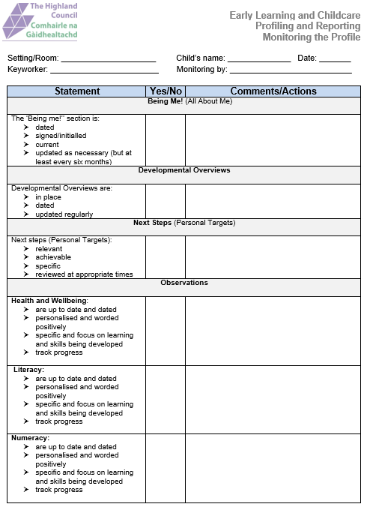
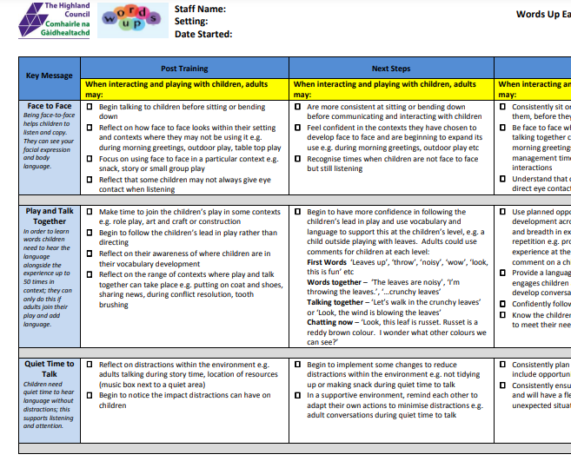
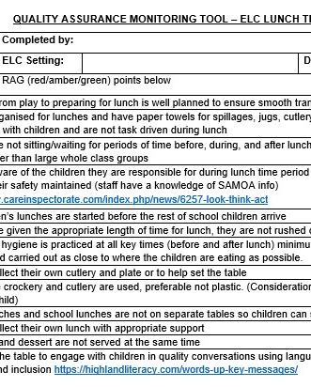
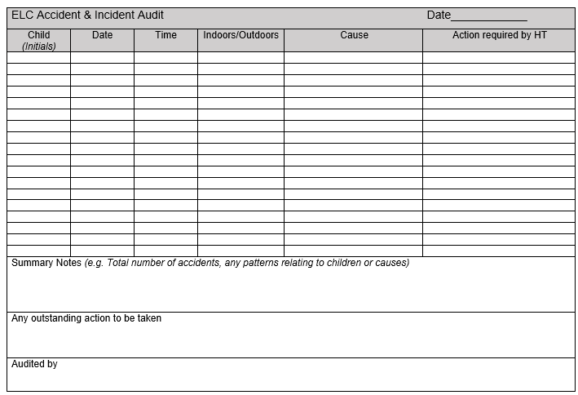
Monitoring
&
Audit Tools
Monitoring the Profile
https://elchighland.com/profiling-and-reporting/
Words Up
https://highlandliteracy.com/wp-content/uploads/2019/05/words-up-one-early-monitoring-tool-march-2019.pdf
ELC Lunchtime Experiences
https://elchighland.com/2023/01/24/new-elc-guidance-to-support-lunchtime-and-snack-experiences/
Accident and Incident
https://elchighland.com/operational-aspects/

Slide 17
Duty of Candour
Report
What do you need to do?
More information on Duty of Candour can be found on the Care Inspectorate hub.
Training is available on Turas
Exemplars of Duty of Candour reports can be found on the ELC Blog on the operational page.

Slide 18

Building an
Effective Team

Slide 19

Induction Process
National Induction for all new early years staff is mandatory

Slide 20
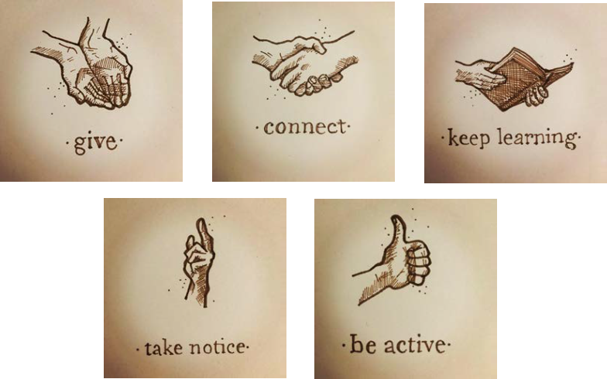
Supporting effective teamwork
Good communication
Team meetings
Support and Supervision
Employee Review and Development(ERDs)
Support and Supervision template
ERD Form

Slide 21
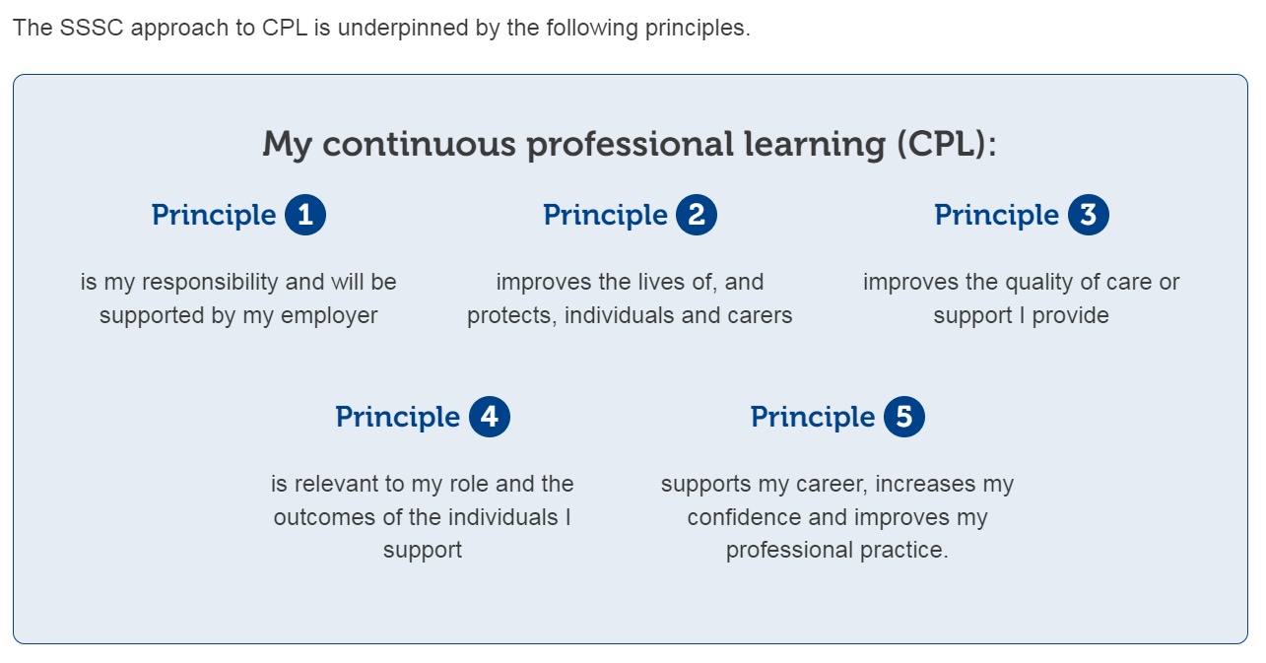


Continuous
Professional Learning

Slide 22
Highland Council Continuous Professional Learning (CPL)
https://elchighland.com/continuous-professional-learning/
A robust process for CPL can be found on the Highland ELC Blog: Highland ELC Learning Framework
https://elchighland.com/continuous-professional-learning/

Slide 23

Encouraging Leadership
Encouraging staff to take on leadership roles
Supporting this with relevant CPL
Ensuring time for staff to cascade information from training
Enabling time for training to be implemented, monitored and reflected on
Ensuring all staff know that they are responsible for moving settings forward and self-evaluation

Slide 24
Roles and Responsibilities of
ELC staff
EYP Job description
SEYP job description
SW job description
Sharing Responsibility
Leadership opportunities
Key Worker Role
ELC Staff Job Specifications

Slide 25
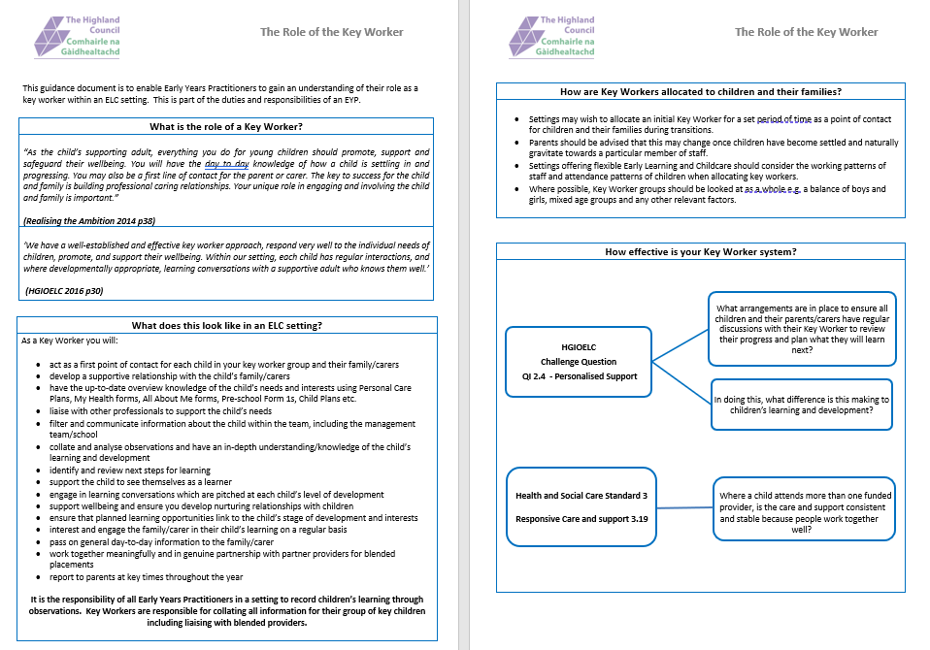
Role of the key worker
This guidance document, that can be found on the ELC Highland blog, is to enable Early Years Practitioners to gain an understanding of their role as a key worker within an ELC setting. This is part of the duties and responsibilities of an EYP.

Slide 26
Managing an ELC Setting
Part 2
Early Years Education Support Officers

Slide 27


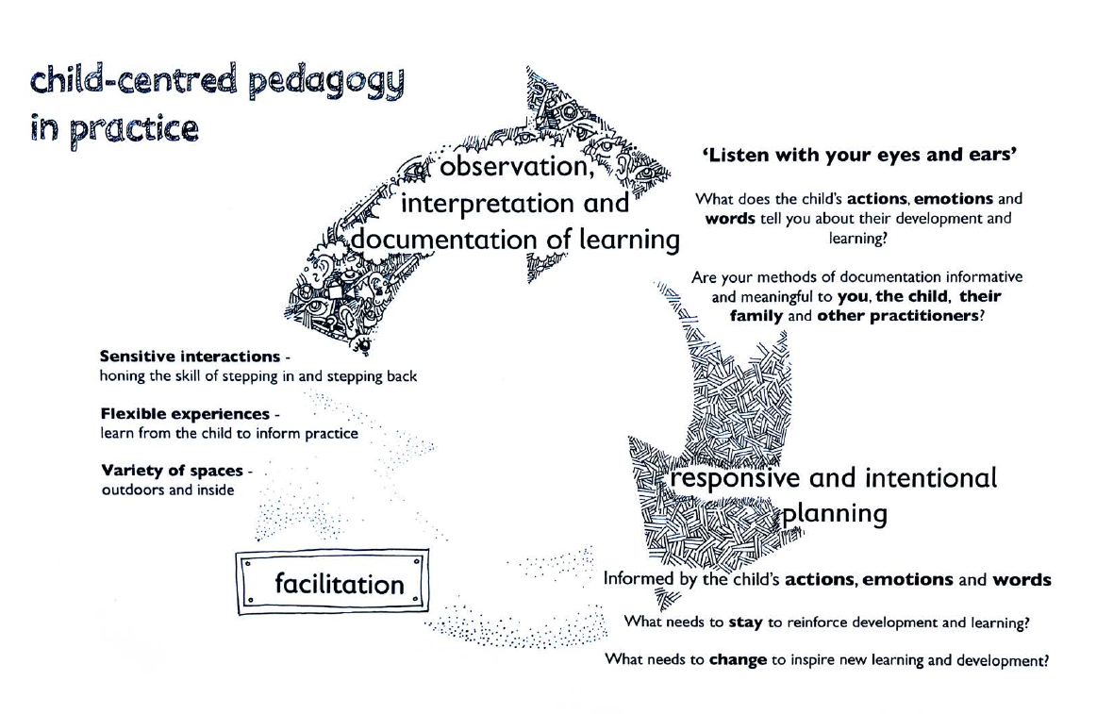

Quality Framework QI 1.3
“Children are empowered to be fully involved in their play and learning through the skilled interactions and actions of staff.”
Planning in ELC
HGIOELC QI 2.3 Learning teaching and assessment:
“Observations are used to inform appropriate well-timed interventions and future learning.”
Approaches to Planning in ELC - Recording
Quality Observation in ELC Settings - Slides

Slide 28

https://education.gov.scot/resources/early-level-play-pedagogy-toolkit/

Slide 29
High-quality Provision
Realising the Ambition states:
'We know it is important for settings to offer children interactions, experiences and spaces that are developmentally appropriate.'
Start with the child
Remember that your interactions with the child are a key aspect of the learning environment.
Open-ended experiences and materials allow more exploration.
Outdoor environments often contain more opportunity to stimulate children's curiosity and wonder for learning than indoors
Experiences
Spaces
Interactions

Slide 30
Progress
How do you track children’s progress?
Planning
Profiles
Observations
Next steps
Developmental Overviews
Key worker attainment conversations
Literacy and Numeracy Progressions
Partnerships
Parental Engagement
https://elchighland.com/2024/09/17/tracking-and-monitoring-in-elc/

Slide 31

Gaelic Medium Settings
This guidance should be used with Education Scotland’s advice on Gaelic Medium Education (GME) to ensure that the principles of total immersion are followed. Interactions in Gaelic are a key driver in planning progression in the curriculum for GME.
Realising the Ambition, pg. 12
+
Highland Play Pedagogy in GME Rationale
Advice on Gaelic Education Updated March 2022

Slide 32
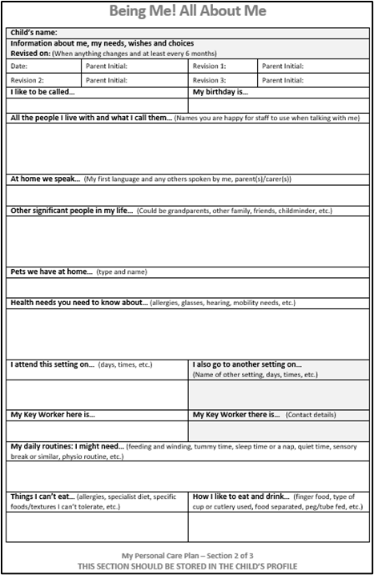
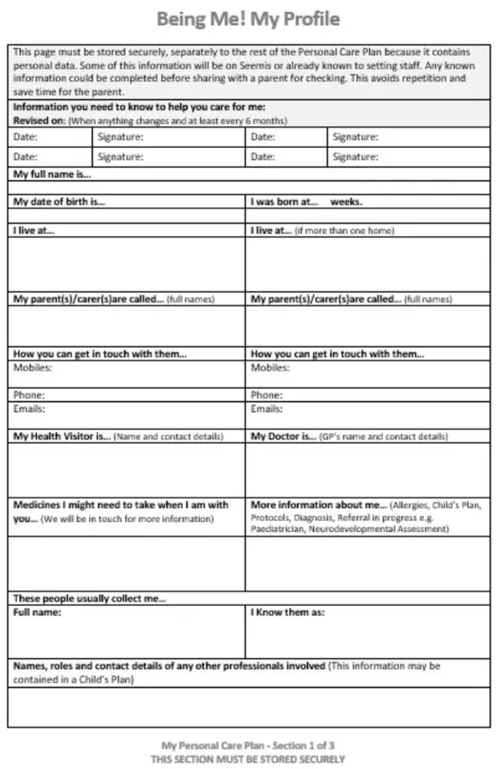
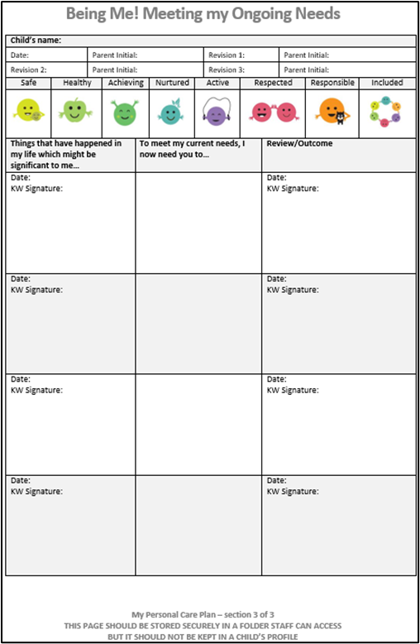
Being Me - My Personal Plan
All About Me
Being Me
Being Me
My Profile
Meeting My Ongoing Needs

Slide 33
Being Me – Don't forget...!
! All 3 forms must be completed within 28 days of a child starting in the setting
! All About me and My Profile must be reviewed, signed and dated at least every 6 months
! Meeting My Ongoing Needs to be updated as required and reviewed at least every 6 months
! Meeting My Ongoing Needs must include strategies to support a child's health, welfare and safety needs and should be worded sensitively.
! All About Me kept in children's profiles
! My Profile and meeting My Ongoing Needs kept with other confidential information
Being Me; My Personal Care Plan Guidance - https://elchighland.com/being-me/
Being Me Bitesize https://www.youtube.com/watch?v=AT3Bee6AfZE

Slide 34

Individual support
Additional information is gathered and noted in Meeting My Ongoing Needs
My all about me contains information about my personal needs
My needs are noted in Meeting My Ongoing Needs
Include actions from child’s plan in Meeting My Ongoing Needs
Note strategies & outcomes in Meeting My Ongoing Needs
Strategies used are meeting my needs
I have a child’s plan
My needs are reviewed by staff and parents
Information feeds back into next child’s plan review
My needs are reviewed by staff, other professionals and parents
Additional needs are identified and Pre-school form 1
initiated
Strategies used are not meeting my needs
Child’s plan established
My ongoing needs sheet could also include advice and strategies from other sources e.g. AHPs, PSHVT/EP, Ways you can help me sheet, training, consultations, reports, Just Ask, etc.
https://www.youtube.com/watch?v=TCn68axG8tQ

Slide 35

Just Ask!
Child development helpline available on Tuesdays and Thursdays 1-4pm
0300 303 1364
The Highland enquiry line is for parents, carers and professionals. If you have any questions or concerns you can talk to an:
Occupational Therapist
Educational Psychologist
Physiotherapist
Primary Mental Health Worker
Speech and Language Therapist
Psychological Services Home Visiting Teacher
Autism Practitioner
Community Learning Disability Nurses
Dietician

Slide 36
Working with other Professionals
Allied Health Professionals | Health Visitors
Physiotherapy Service Childrens.ptservice@Highland.gov.uk | Caithness HealthVisitors.Caithness@highland.gov.uk
Occupational Therapy Service childrens.otservice@highland.gov.uk | Easter Ross HealthVisitors.EastRoss@highland.gov.uk
Speech and Language Therapy Service SLTServiceHighland@Highland.gov.uk | Inverness West HealthVisitors.InvCentral@highland.gov.uk
Paediatric Dietitians paediatricdietitians@highland.gov.uk | Inverness East and Nairn HealthVisitors.InvEastNairn@highland.gov.uk
Educational Psychology Service EducationPsychologists@highland.gov.uk | Lochaber HealthVisitors.Lochaber@highland.gov.uk
 | Mid Ross HealthVisitors.MidRoss@highland.gov.uk
 | Skye, Lochalsh and Wester Ross HealthVisitors.SkyeLWR@highland.gov.uk
 | Sutherland HealthVisitors.Sutherland@highland.gov.uk
 | Inverness West HealthVisitorsInvWest@Highland.gov.uk
 | Badenoch and Strathspey HealthVisitors.BS@highland.gov.uk

Slide 37
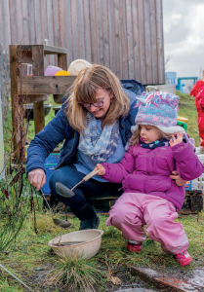
Family Engagement
Family Engagement – Early Learning and Childcare in Highland (elchighland.com)
Education Scotland Engaging Families
Care Inspectorate Practice Note: Me, My Family and Childcare
Connecting with Families

Slide 38
Blended Placements
Blended Model: The model where children are attending two or more settings, managed by different providers, who are working together to provide them with their entitlement to ELC. The National Standard Page 55
Highland Council Guidance on Blended Placements
https://elchighland.com/2022/01/07/funding-follows-the-child-the-national-standard/

Slide 39
Blended Placements
Introductory call within 2 weeks of child starting
Regular contact by face-to-face meetings,
communication notebook, Teams, emails or phone calls
Purpose:
A general catch up around the child – Health and Wellbeing
Sharing of Developmental Overviews
Sharing of next steps
Sharing of any other relevant information

Slide 40
Deferred or early entry to School
There is an agreed process for parents and staff to follow if it is being considered that a pupil be educated out-with their peer group.
The Highland Council guidance provides details of the process and outlines:
the issues to consider
reasons and requests for deferral
when request for deferral can be made
early entry into school processes and assessment
Guidance on being educated out-with the peer group including deferred or early entry to school

Slide 41

Self-evaluation in ELC
Led by the manager or whoever has ELC management time​
​
A process rather than an event​
​
Taking a theme, aspect, question or QI and reflecting on it in depth ​
​
Using key documents that can support you to explore and evaluate your chosen focus​
​
All staff, families, children and other professionals should be involved​

Slide 42
Recording self-evaluation
How are we doing?
How do we know?
What are we going to do now?
What was the impact?
Recording of Self-evaluation Training -https://www.youtube.com/watch?v=cKhutID7o-o​

Slide 43
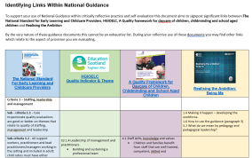
Identifying links document
https://elchighland.com/2021/11/25/self-evaluation-making-links-between-the-national-standard-for-early-learning-and-childcare-providers-and-other-national-frameworks/

Slide 44
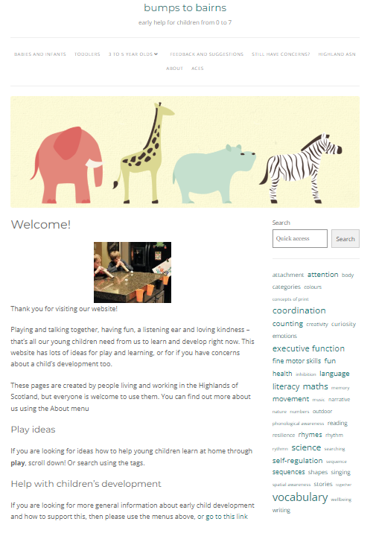
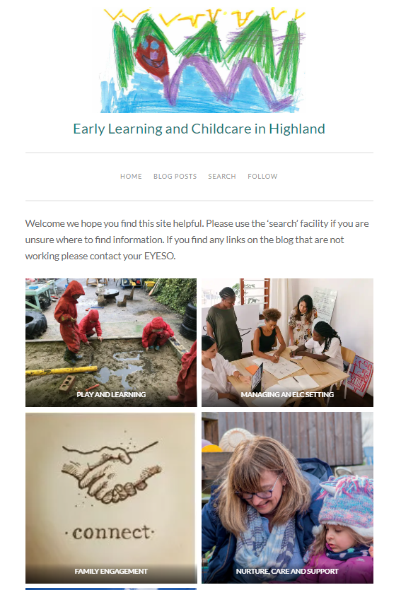

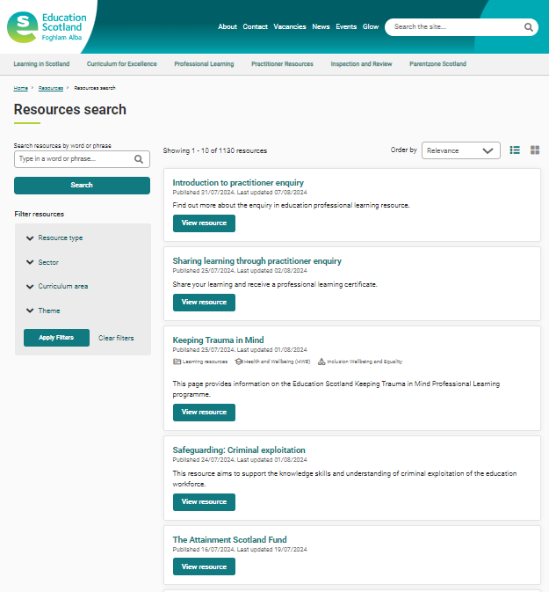

Keeping up-to-date
ELC Highland Blog
https://elchighland.com/
Bumps2Bairns
https://bumps2bairns.com/
National Improvement Hub
https://education.gov.scot/resources/resources-search/?orderAlias=relevance
Care Inspectorate Hub
https://hub.careinspectorate.com/
SharePoint
https://highlandcouncil1.sharepoint.com/sites/staffconnections/

Slide 45

Thank you for listening!

