Slide 1
ELC Management Time and
Quality Assurance

Slide 2
ELC management time – how much?
Proportionate to the number of children in the ELC setting
Ranges from 0.1 to 0.4

Slide 3
ELC management time – who?
HT
DHT
PT

Slide 4
ELC management time
Plan & ringfence
Be visible
Use in ELC setting where possible
Walk-around visits

Slide 5
Using your
ELC management time
Prioritise responsibilities
on your QA Calendar, such as:
Curriculum support
Monitoring
Taking a lead in self-evaluation
Induction for new staff
Conducting ERDs and Support & Supervision meetings
CPL
Policy review
Risk Assessment
Managing staff work patterns
Supporting staff/staff meetings

Slide 6

Quality Assurance Calendar
All settings must have a Quality Assurance Calendar in place
A working document and can be dated/annotated/highlighted
Should be visible, e.g. displayed in the setting/office
Can be colour coded to identify responsibilities
Care Inspectorate’s quality assurance bitesize session https://www.youtube.com/watch?v=HAQhwMEiWzQ
Care Inspectorate’s quality assurance guidance Quality Assurance Calendars

Slide 7
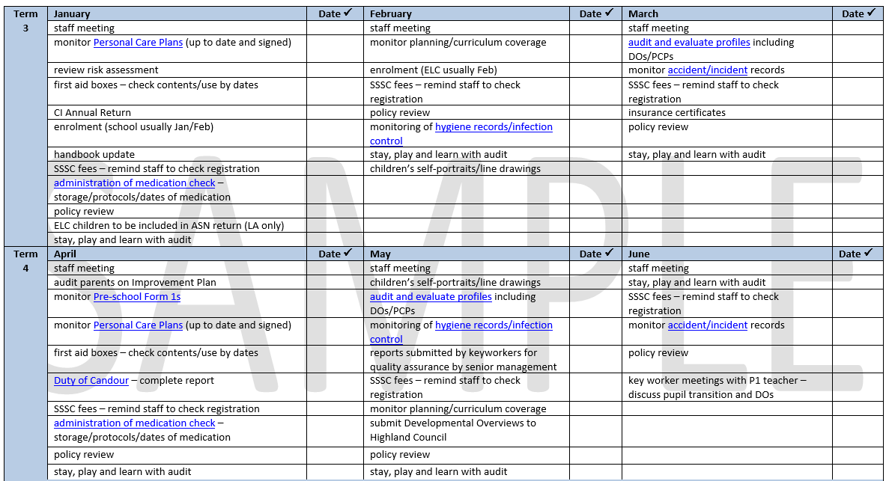
Sample
QA Calendar
https://elchighland.com/quality-assurance-and-improvement/

Slide 8
Quality Assurance
Essential to identify areas for improvement
Evidence of all monitoring activity to be filed in a QA Folder
Undertaken as per your QA Calendar
Feedback provided
Next steps agreed and revisited
So what? Impact to be documented

Slide 9
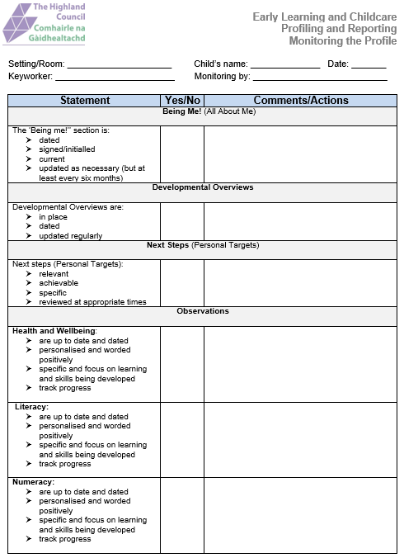
Monitoring & Audit Tools
Monitoring
the
Profile
https://elchighland.com/profiling-and-reporting/

Slide 10
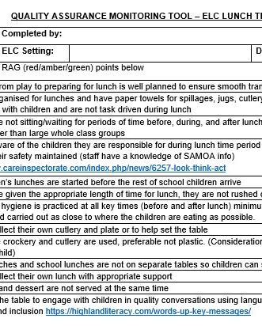
Lunchtime Experiences
Audit
https://elchighland.com/2023/01/24/new-elc-guidance-to-support-lunchtime-and-snack-experiences/
Supporting documents - Setting the Table Guidance - gov.scot
Good practice guidance: prevention and management of choking episodes in babies and children

Slide 11
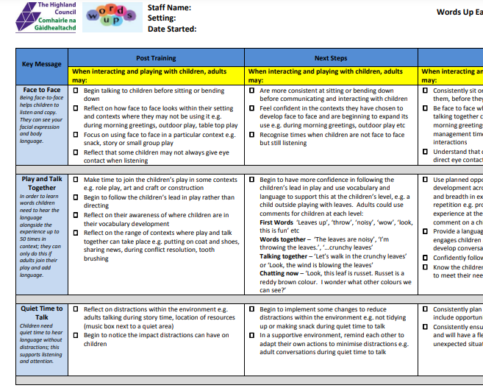
Words Up Audit Tool
https://highlandliteracy.com/wp-content/uploads/2019/05/words-up-one-early-monitoring-tool-march-2019.pdf

Slide 12
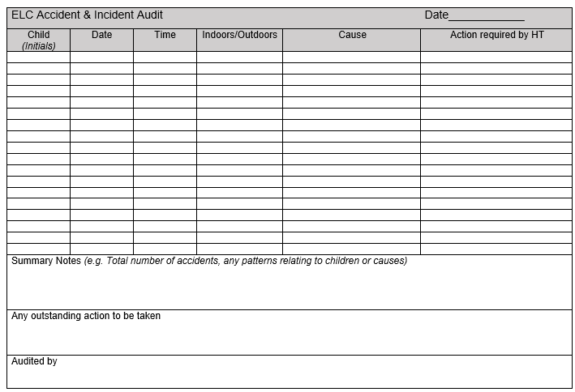
Accident & Incident Audit Tool
https://elchighland.com/operational-aspects/

Slide 13
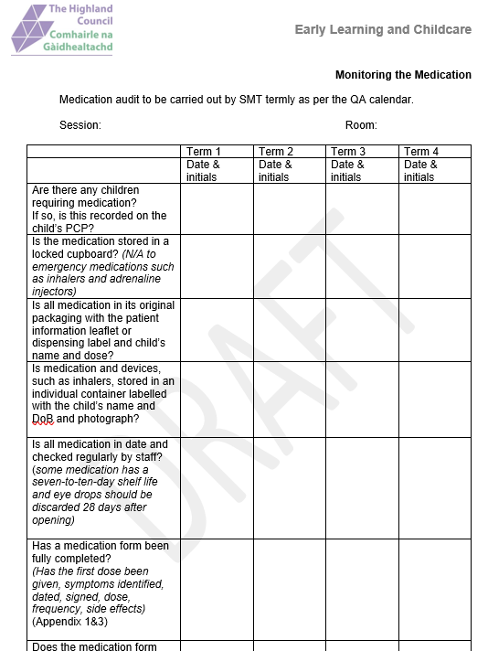
Medication Audit Tool

Slide 14
Other monitoring tools
Please ask your CCM or EYESO

Slide 15

Any questions?

