Slide 1
Inspections in Early Learning & Childcare

Slide 2


Inspections in ELC settings
Education Scotland and the Care Inspectorate
Shared or stand-alone inspections
Inspections may occur within 18 months of each other

Slide 3


Current inspection frameworks

Slide 4

Draft Quality Improvement Framework
https://education.gov.scot/inspection-and-review/inspection-frameworks/quality-improvement-framework-for-the-early-learning-and-childcare-sectors/

Slide 5
Quality Improvement Framework Structure
Leadership Leadership and management of staff and resources Staff skills, knowledge, values and deployment Leadership of continuous improvement | Children thrive and develop in quality spaces Children experience high quality spaces
Children play and learn Play and learning Curriculum Learning, teaching and assessment | Children are supported to achieve Nurturing care and support Wellbeing, inclusion and equality Children’s progress Safeguarding and child protection

Slide 6
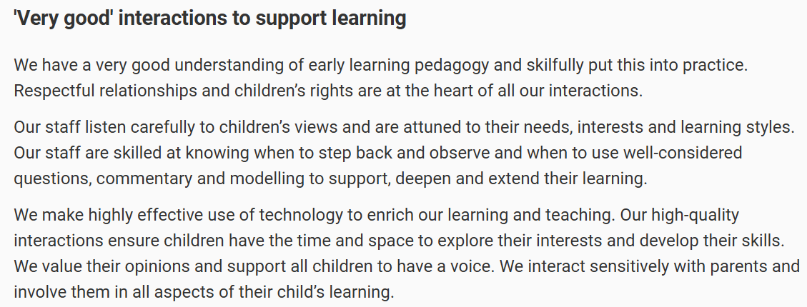
“Very good” illustration

Slide 7
Quality Indicators for inspections
Education Scotland QIs | Care Inspectorate QIs
Leadership of continuous improvement Curriculum Learning, teaching and assessment Wellbeing, inclusion and equality Children’s progress Safeguarding and child protection | Leadership and management of staff and resources Staff skills, knowledge, values and deployment Children experience high quality spaces. Play and learning Nurturing care and support Safeguarding and child protection

Slide 8
The PRAISE Framework
Purpose - being clear about the overall purpose of the inspection/review and retaining this throughout. Creating a shared agenda with staff in the organisation and amongst members of the inspection/review team.
Relationships - building and maintaining constructive relationships throughout the process as the basis of a high-quality inspection/review.
Awareness - maintaining a high level of awareness of the context in which staff are operating, of their feelings and reactions to the process and of the inspector's own approach and its impact.
Information gathering - careful inquiry to gather and analyse evidence. Retaining an objective stance, testing assumptions and assimilating data before evaluating.
Sharing information - communicating effectively throughout the process to prepare and inform staff. Encouraging staff to be open in providing their perspective and sharing findings as the inspection/review progresses.
Enabling - treating people with respect, engaging them in professional dialogue, recognising their efforts and sharing findings in a constructive way to encourage ownership and learning to take place.

Slide 9
Education Scotland inspections
Over 2 weeks’ notice
Full or short model inspection
Possible shared inspection with Care Inspectorate
Inform EYESO
Pre-inspection support visits
Education Scotland Guidance for ELC Settings/

Slide 10
Before the inspection
Questionnaires to be completed by staff, parents and partners
HT to complete the Self-evaluation Summary Form
HT to complete the Child Protection and Safeguarding Self-evaluation Form
Other information to be submitted will be provided
Telephone or Teams call with Inspection Administrator (IA)
Telephone call with Managing Inspector (MI)

Slide 11
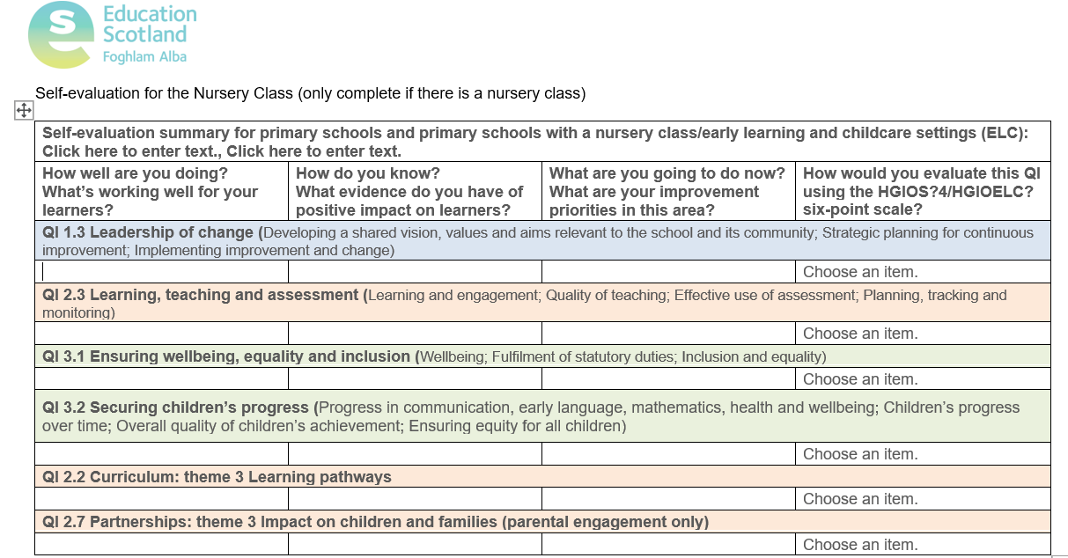
Self-evaluation Summary Form

Slide 12
Education Scotland 6-point grading scale
 | Grade | Meaning
6 | Excellent | Outstanding, sector leading
5 | Very good | Major strengths
4 | Good | Important strengths with some areas for improvement
3 | Satisfactory | Strengths just outweigh weaknesses
2 | Weak | Important weaknesses
1 | Unsatisfactory | Major weaknesses

Slide 13
During the inspection – Day 1
Tour of school including ELC
Scoping meeting – HT to brief the inspection team based on the completed self-evaluation summary form, providing a clear sense of the setting’s journey.
Focus on high-level messages:
giving a clear account of strengths and aspects for development
demonstrating where the setting is improving and showing how they know
identifying the key sources of evidence which underpin their knowledge of the setting's performance and improvement, and making these available
showing how they prioritise areas for improvement.
Meeting for staff to be introduced to the
inspection team

Slide 14
Short model -Day 2 Full model – Days 2 & 3
Visits to the ELC setting
Observation of practice
Talking with children and staff
Focus meeting with parents/carers
Examining evidence – Learning profiles, self-evaluation, quality assurance, personal care plans etc.

Slide 15
Short model – Day 3 Full model - Day 4
Feedback meeting
Sharing of inspection findings
Strengths and areas for improvement identified and discussed
Provisional grades shared
Further dialogue

Slide 16
After the inspection
Summary of inspection findings (SIF)
Letter to parents/carers
Publication of SIF and letter on Education Scotland’s website

Slide 17
When further inspection activity is required
Action Plan created, implemented and reviewed regularly
Reinspection within a year of the publication of the report
Enhanced support from EYESO
Letter sent to parents/carers informing them of progress made since previous inspection

Slide 18
Care Inspectorate inspections
Unannounced
Questionnaires received for staff and parents/carers
Inform CCM and EYESO
How we inspect regulated services; guidance for providers of regulated care settings and the public
Our approach to scrutiny and improvement

Slide 19
Before the inspection
Be ‘inspection ready’
Child protection
Infection, prevention and control
Medication
Accident/incident records
Improvement/Action Plan
Quality Assurance and Self-evaluation
Personal Care Plans

Slide 20
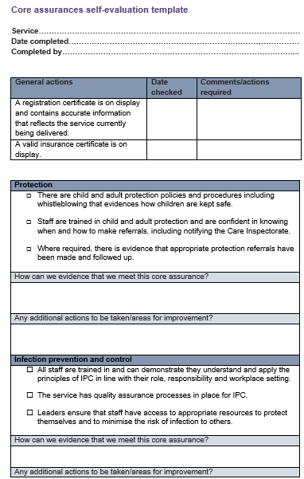
Core Assurances Template
Core Assurances Template

Slide 21
Scrutiny Assessment Tool (SAT)
Used by Care Inspectorate to identify indicators of potential concern
Updated by care Inspectorate in response to information they receive and when they carry out inspections, including information from the Annual Return, notification history, complaints or concerns and any recent variations
Rating of high, medium or low
Can be accessed on eForms under ‘documents’
Can change suddenly so check regularly

Slide 22
During the inspection - Day 1
Talk with parents/carers at drop off and pick up times
Meet with HT and whoever has ELC management time
Visit to ELC setting, including a Sofi observation
Talk with staff/children

Slide 23
Purpose: To evaluate the kind of experience a child is having To see interactions from the child’s perspective To determine whether the support a child is receiving is effective
SOFI Observation (Short Observational Framework for Inspection)
Observation of one child for 30-45 minutes
Score - Positive, neutral or negative
Findings shared at feedback and can be reflected in the report and grades.

Slide 24
During the inspection - Day 2
Provisional grades awarded
Continuation of inspection
Feedback

Slide 25
After the inspection
Draft report received within 15 working days
Opportunity to respond to factual errors via the Error Response Form within 10 working days
Final report published on Care Inspectorate’s website

Slide 26
When a setting falls below the National Standard
Requirements to be met within a specified timescale
Areas for Improvement to be met before the reinspection visit
Action Plan created, implemented and reviewed regularly
Enhanced support from CCM and/or EYESO

Slide 27
Care Inspectorate’s 6-point grading scale
Grade |  | Meaning
6 | Excellent | Outstanding or sector leading
5 | Very good | Major strengths
4 | Good | Important strengths with some areas for improvement
3 | Adequate | Strengths just outweigh weaknesses
2 | Weak | Important weaknesses – priority action required
1 | Unsatisfactory | Major weaknesses – urgent remedial action required

Slide 28

Any questions? Please contact your CCM or EYESO

