Slide 1


Early Years Planning for managers 23rd September 2025

Slide 2
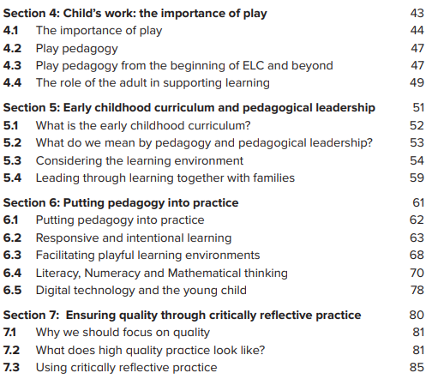


Slide 3
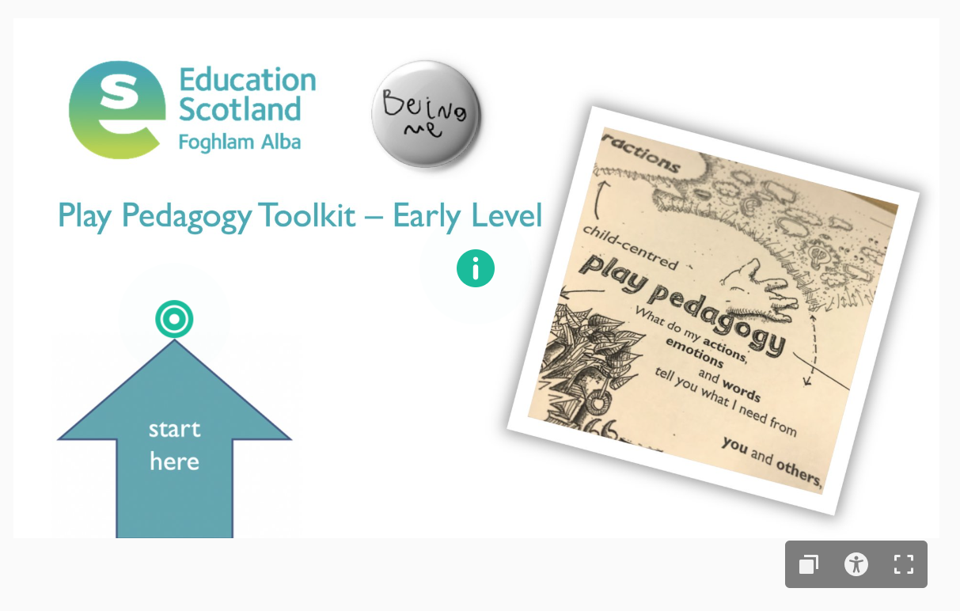
Education Scotland early level play pedagogy toolkit

Slide 4
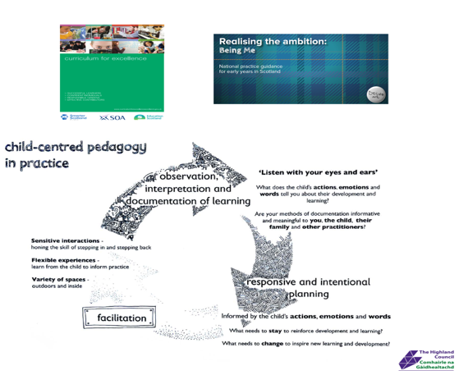
Quality Improvement Framework:
Play, learning and developing
“Children are at the centre of all planning. We are skilled in recognising the different stages in children’s play and learning and these are thoroughly considered when planning new experiences and opportunities. We use observations of individual children’s patterns of play to plan, support, challenge and extend their learning. This enables children to make progress at their own pace.”
Learning, teaching and assessment
“Our approach to documenting learning empowers children to talk about their achievements and consider what they might learn next. Our planning for children’s learning is both responsive and intentional to ensure an appropriate balance of child-led, adult-initiated and adult-directed experiences. We take account of children’s ideas, interests and needs and use imaginative and appropriate ways to involve them in planning learning. We plan high-quality experiences that are relevant to children and families.”

Slide 5
“Learning through play requires skilful interactions and conversations in environments that support and extend thinking and actions. It requires adults who are both playful and knowledgeable of the building blocks of early development and learning in order to support and progress learning appropriately.”
Realising the Ambition p 68

Slide 6
Key elements:
context (because/starting point)
children’s and adults voice, thoughts and discoveries
mark making and adult writing
photos, research, real things …
PLODS, add on, side tracks, new directions
skills and learning – linking to curriculum
this is planning so remember to include – challenge and enjoyment, breadth, progression, depth, personalisation and choice, coherence and relevance.
A balance of child and adult initiated/responsive and intentional

Slide 7
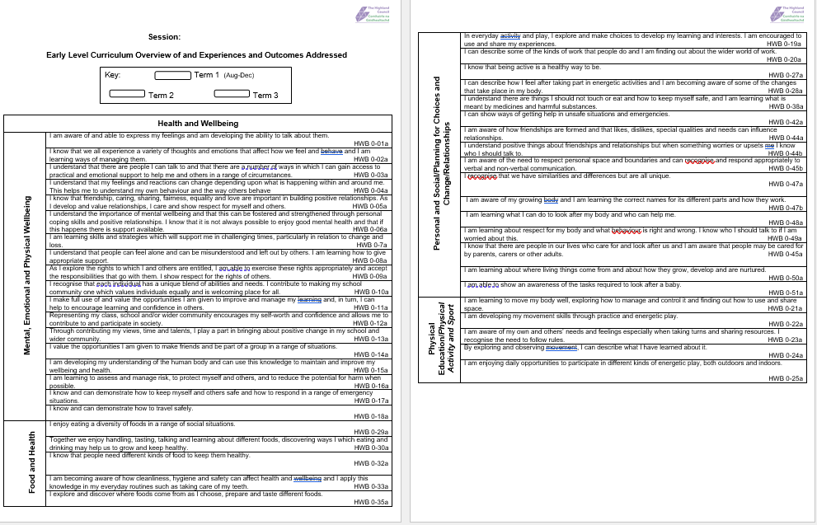

Slide 8
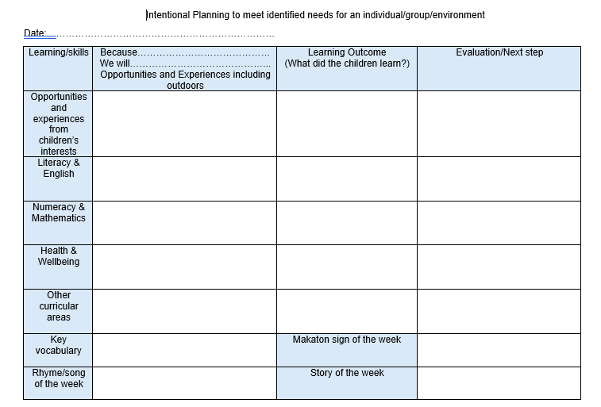
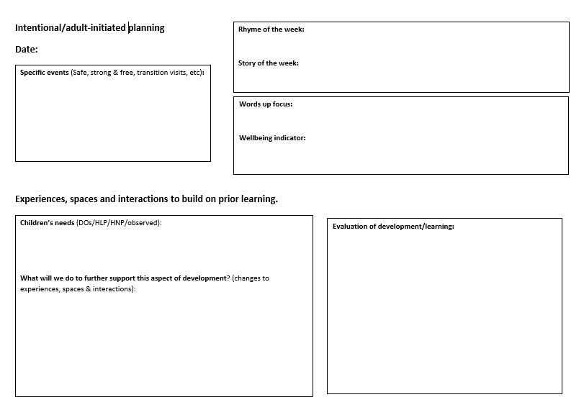
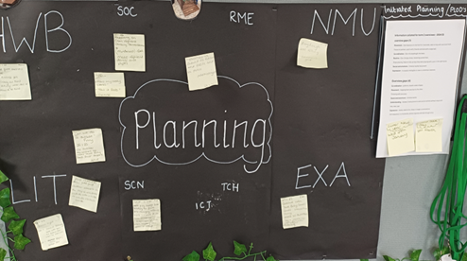
Developing the right balance between child-initiated, adult initiated and adult-directed experiences, will depend on the uniqueness of the needs of each setting’s children and wider contexts; including the cultural environment in which children learn and play. RTA p49

Slide 9
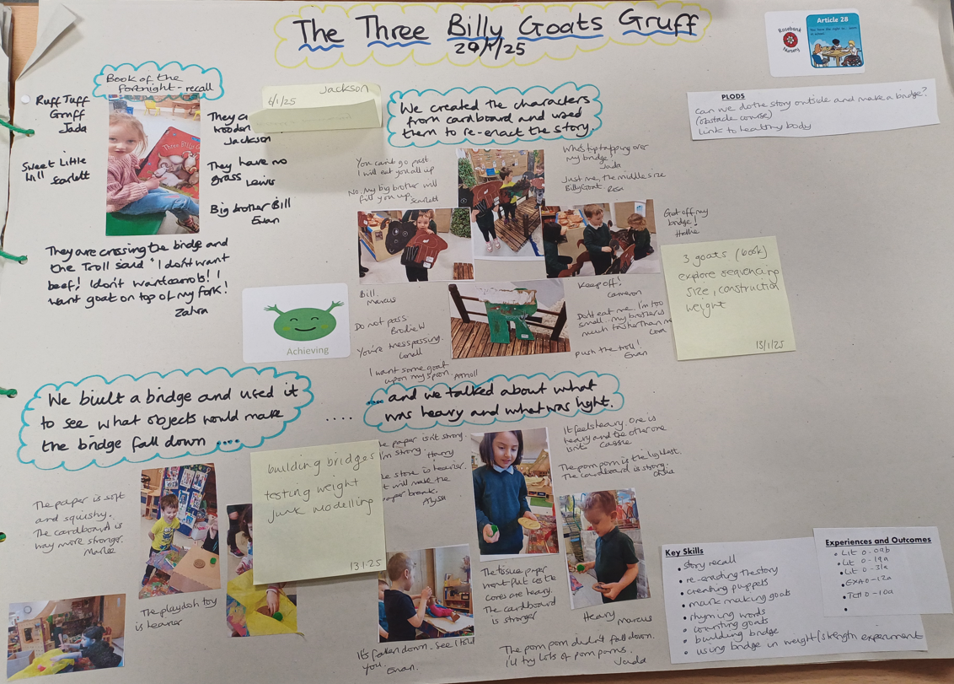
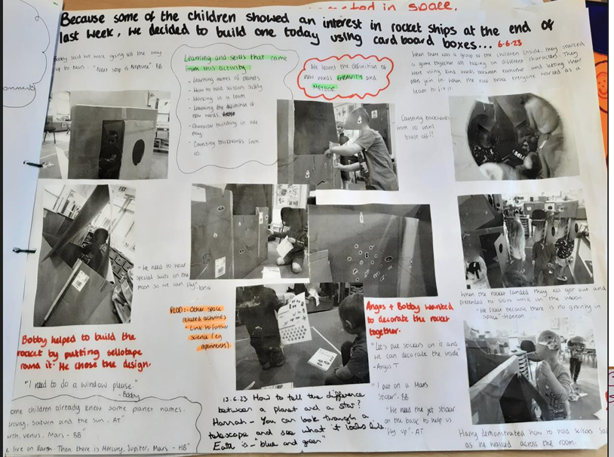
Early level planning is typically centered around the interests and curiosities of the children. This encourages inquiry-based learning, where children's questions and ideas drive the exploration and learning process.

Slide 10
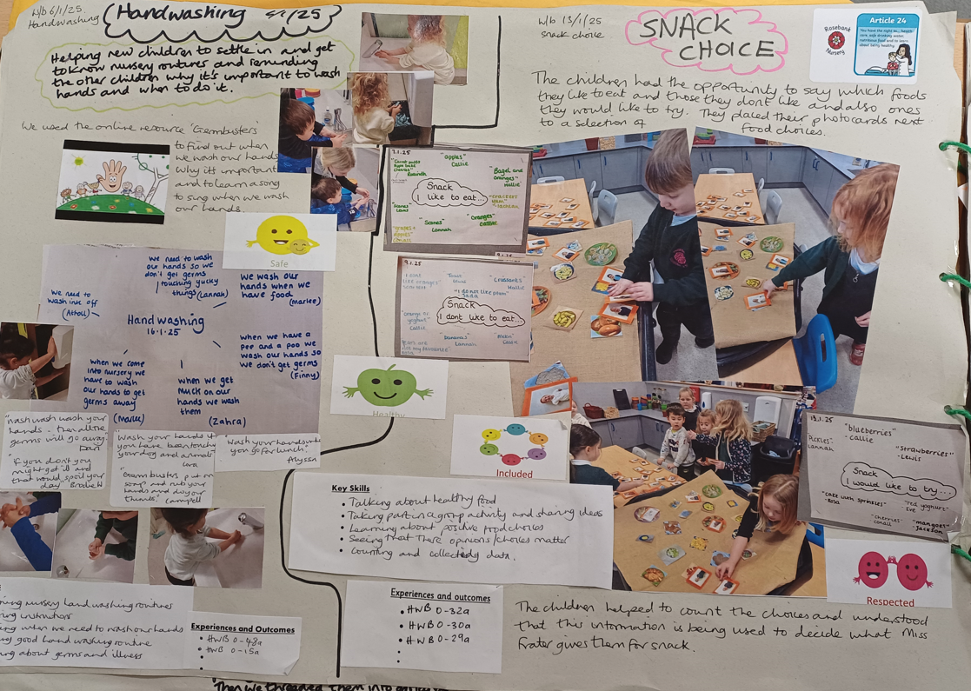
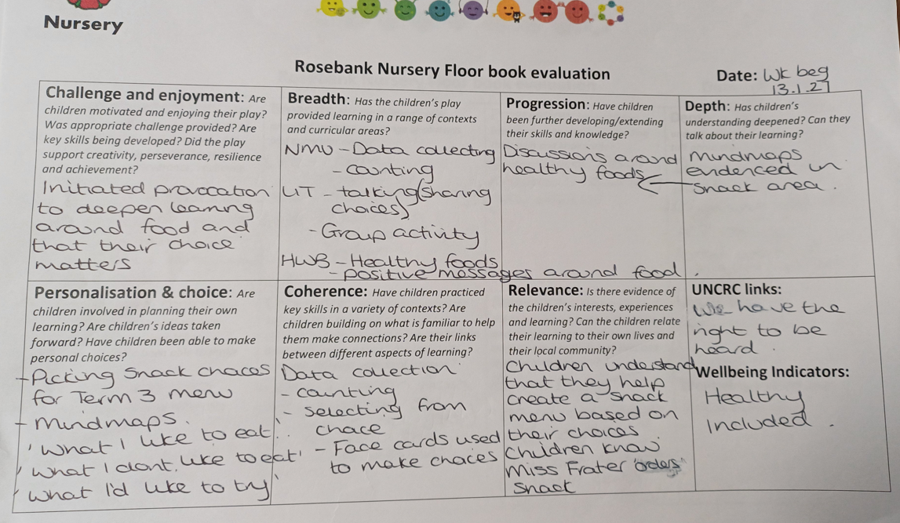

Slide 11
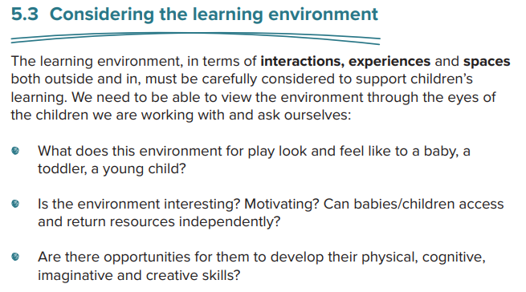
It is important that we provide meaningful and rich contexts and opportunities for children to develop a wide range of skills such as early literacy and numeracy.
As pedagogical leaders we should know the purpose and possibilities of the materials we provide outdoors and indoors. It is essential that we regularly evaluate how children are using the spaces within the environment and make changes and additions when required. Children should be involved in developing and caring for their environment. By involving children fully in planning their learning they will begin to understand the importance of caring for their environment and resources.

Slide 12
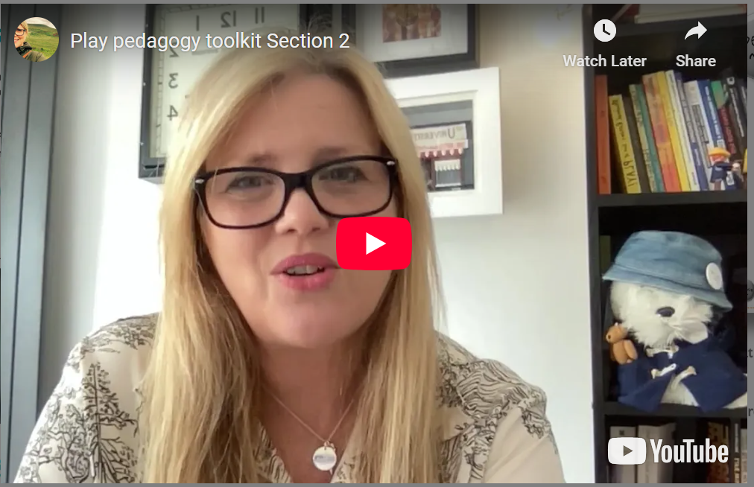
Section 2 Play Pedagogy Toolkit, Lyn Taylor from Education Scotland.

Slide 13
Self-evaluation and monitoring
Plan time to monitor and evaluate your process for planning and the environment (interactions, experiences and spaces).
Use national documents and other tools to support your evaluations: the quality improvement framework, Realising the ambition, Education Scotland’s play pedagogy toolkit.
Ensure you and your staff take time to reflect.
Involve children and families.
Impact!

Slide 14

Self-evaluation
Challenge questions:
Learning, teaching and assessment:
How well does the balance of intentional and responsive planning allow
for breadth, depth, challenge and progress across the curriculum?
In what ways do children influence planning to take their interests forward?
How do we ensure that we use a rights-based approach to learning, teaching and
assessment?
In what ways do children have the opportunity to be independent, responsible, and lead their
own learning?
Play, learning and developing
How do we maximise opportunities for children to be challenged, creative and engaged in their play and learning?
How well do we support and encourage children’s natural curiosity, creativity and problem solving?
How can children be supported to have confidence in leading their own learning?
How do we ensure we keep up to date with relevant theory and demonstrate how our understanding of child development supports high-quality play and learning experiences?
Quality improvement framework for early learning and childcare.

Slide 15
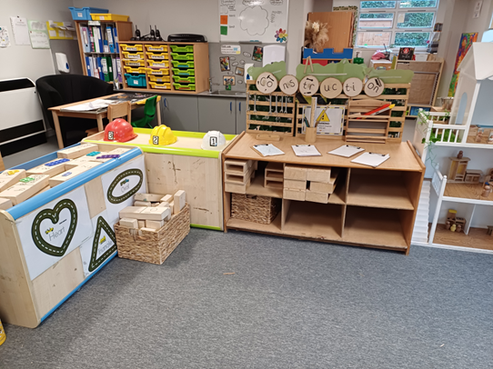
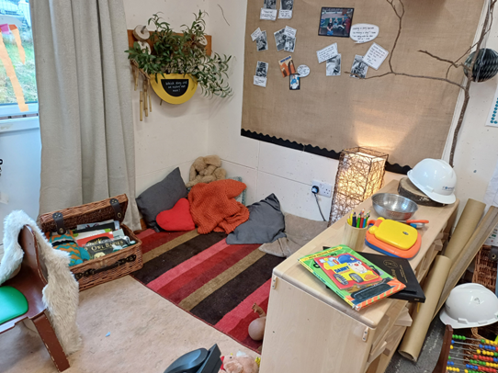
Interactions, experiences and spaces
How often do you look at the space from the eyes of the children?
How do you know your spaces and experiences both indoors and outdoors are ‘working’ for your children?
How do you know that quality interactions are supporting children’s play and learning?

Slide 16
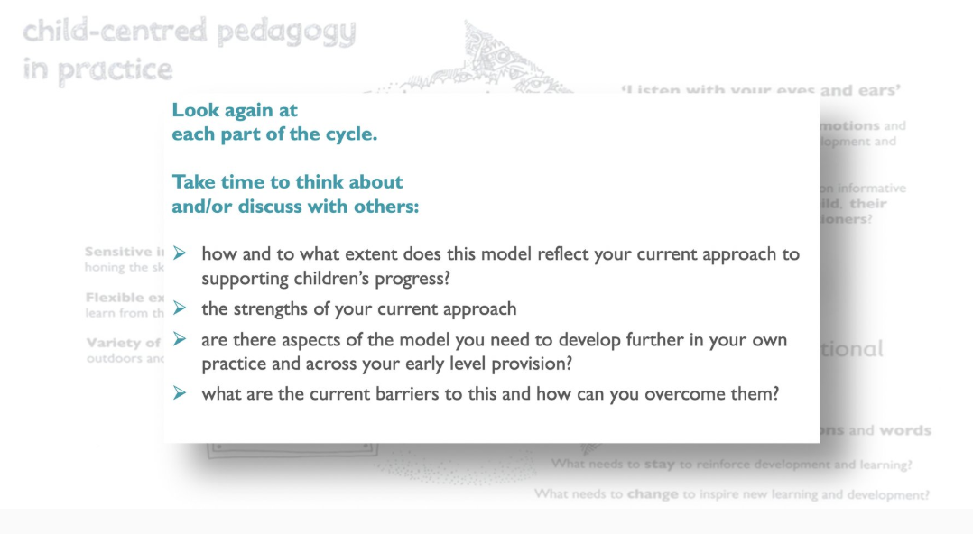

Slide 17
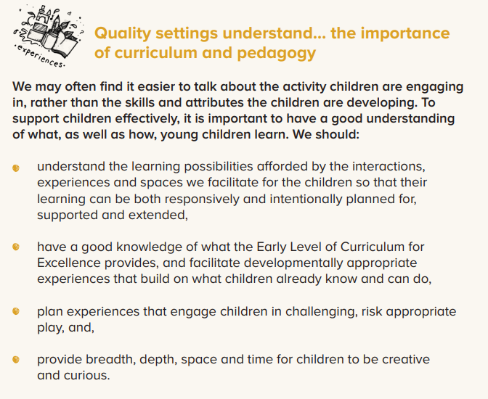

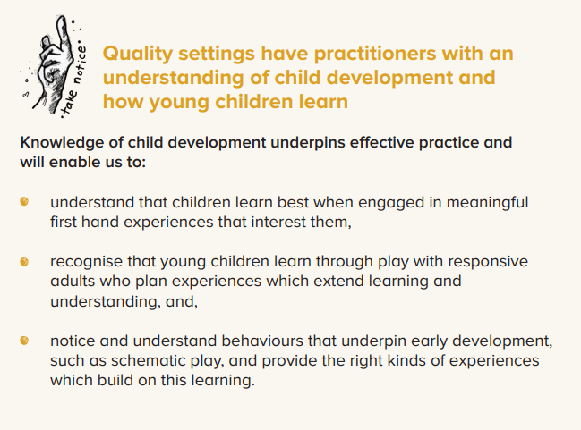

Slide 18
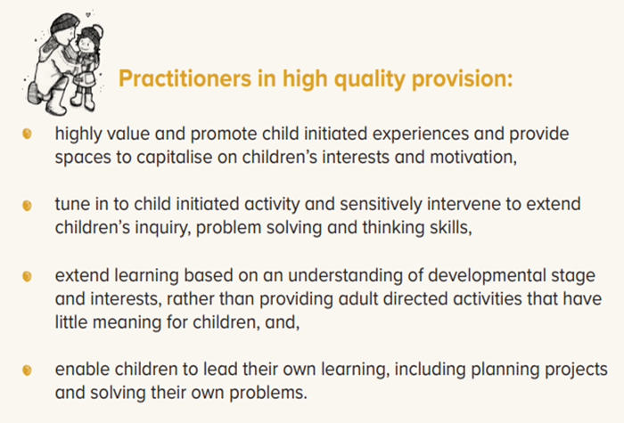
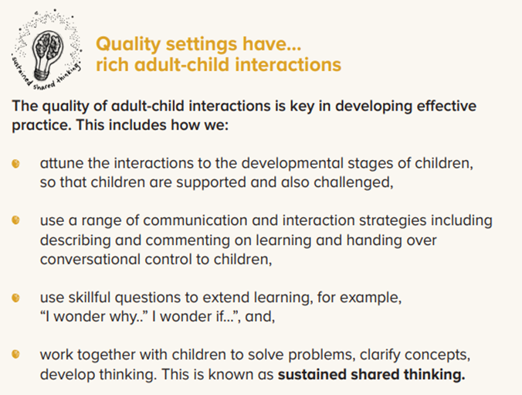

Slide 19
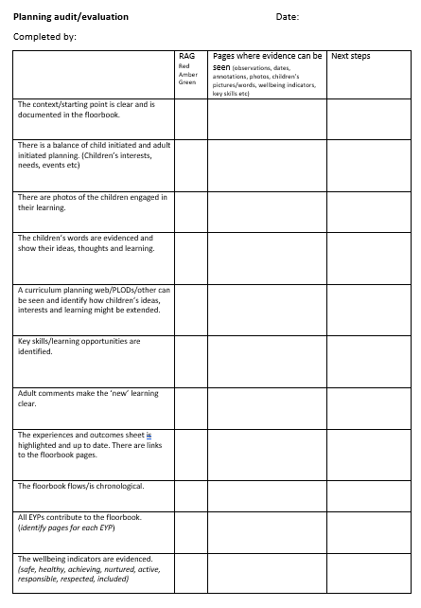

Slide 20



