Slide 1
Family Engagement & Transitions

Slide 2
Family Engagement
Transitions
Improves outcomes for children and sets a strong foundation for their future achievements.
Develops the confidence of families who are the ‘first educators’.
Can have a lasting and positive impact on children’s learning and development.
Can reduce the stress of families and promote their emotional wellbeing.
Can have a positive and lasting impact on children’s learning and development.

Slide 3
Realising the Ambition says….
“Practitioners should seek to learn from parents and carers the significant information about a child’s previous experiences. In saying this we cannot and should not seek to find out everything about a child and their circumstances – this is impossible and often unhelpful. Simply be attentive and know that a baby or young child comes into our care with their own unique set of countless experiences and interactions that have shaped who they are and how they respond to their world.”

Slide 4
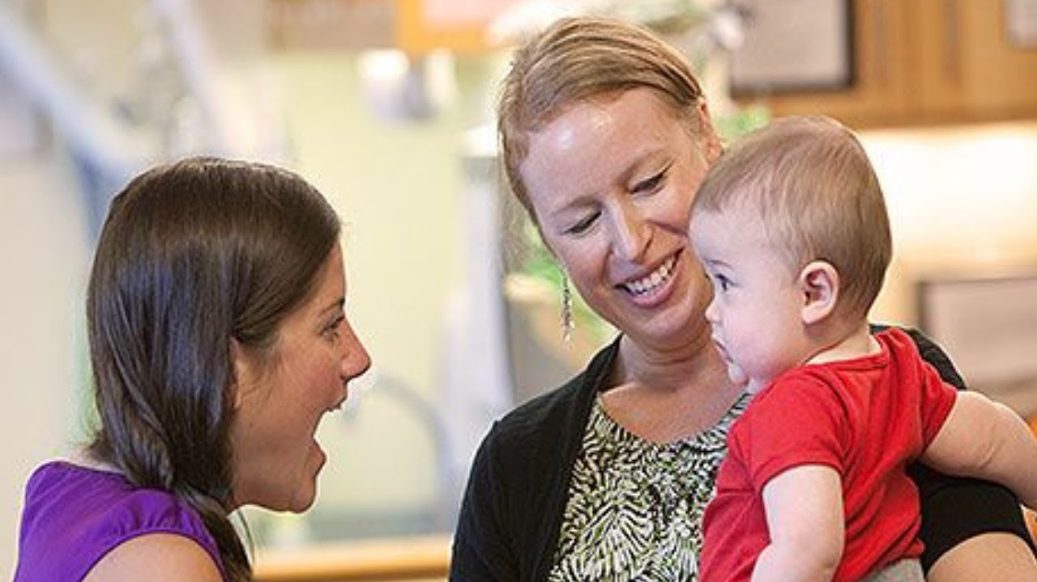
Daily contact
Builds positive relationships
Fosters trust
Two-way information sharing

Slide 5
Do families feel welcome in your ELC Setting? Some questions to consider…
Are all families and children are treated equally and do they receive a warm welcome every day?
Do staff listen attentively to them?
Do staff show that they respect parents’ knowledge, skills and experience?
Do staff clearly know their child well?
Do staff make an effort to get to know them and their family circumstances?
Is the setting flexible and do staff cope with the unexpected and daily challenges parents have, such as a parent who is late because they are held up in traffic?
Do staff keep families well informed. This applies to information about their child and also information about the life of the setting, such as special events?
Are staff non-judgemental? This could apply for example to families that have alternative child- rearing practices.

Slide 6

Online platforms
Generic information
Newsletters
Photos

Slide 7
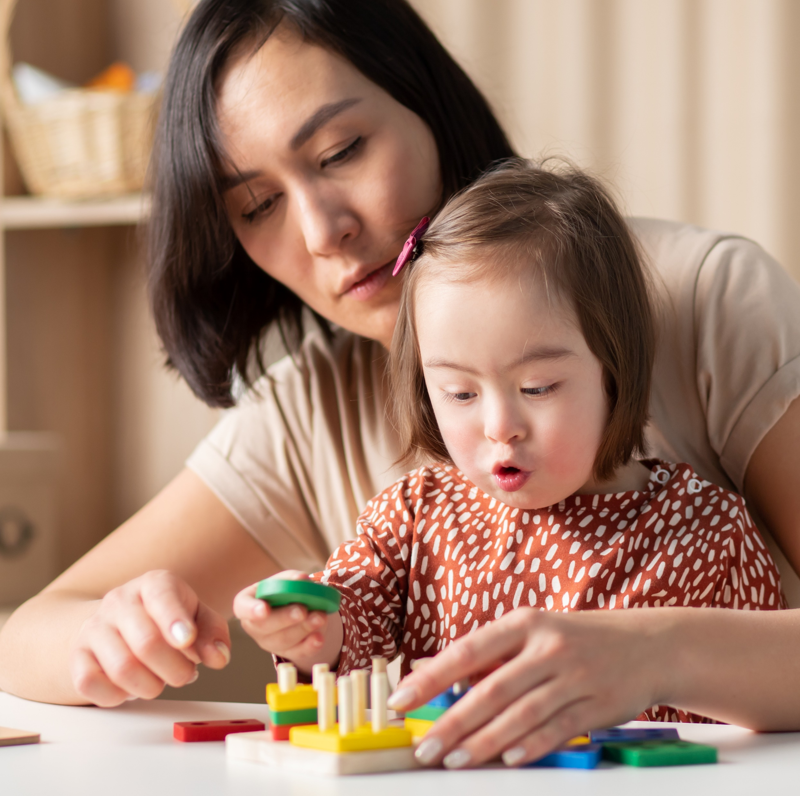
Stay, play and learn sessions
Vary the days to suit different working patterns.
Themed sessions, such as outdoor learning or Numeracy & Mathematics
Sharing the lunchtime time experience with families

Slide 8

Learning Profiles
“Families have regular opportunities to discuss their child’s care and development,
both formally and informally.”
Quality Improvement Framework
September 2025

Slide 9

Learning targets/ Next steps
“Children have high quality individualised learning and development targets, which build upon prior learning. These are reviewed and evaluated regularly with families, and appropriate next steps are identified.”
Quality Improvement Framework September 2025
https://elchighland.com/2024/01/18/new-elc-guidance-on-identifying-next-steps-targets-for-individual-children/

Slide 10
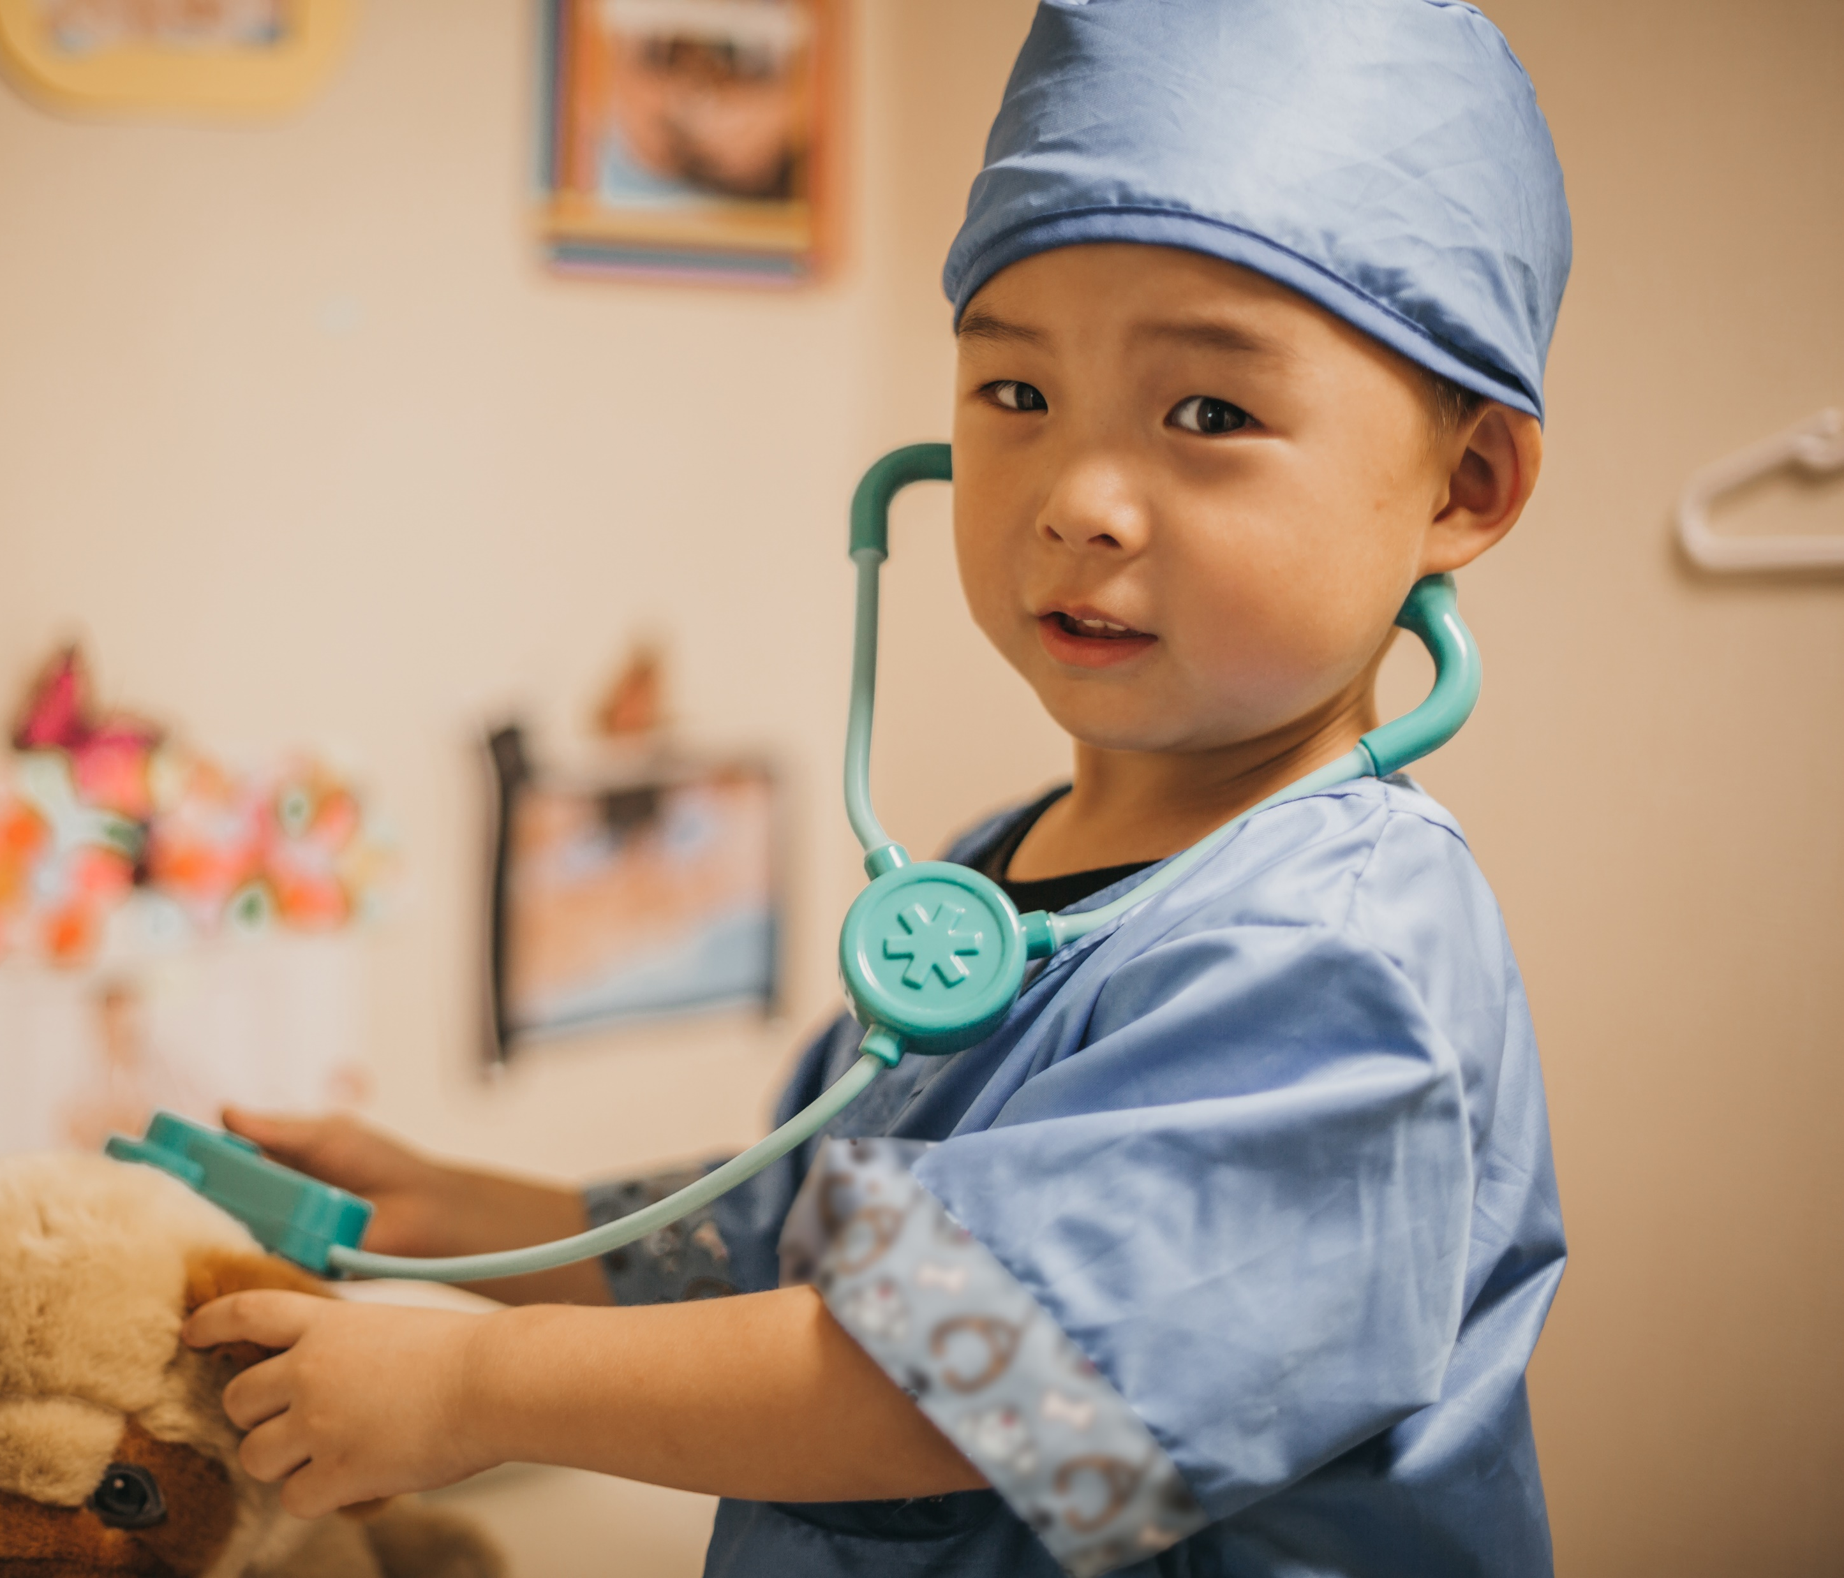

Family skills and experience
“We recognise, learn from, and build upon the strengths that families bring, while sensitively responding to individual needs and circumstances.
This collaborative approach enables us to learn from families, support children's growing sense of self, and ensure our setting remains responsive to their unique needs.”
Quality Improvement framework
September 2025

Slide 11

Consulting with families
Vision, values and aims
Self-evaluation
Improvement Plan
Influencing change – ‘You said…we did…’

Slide 12
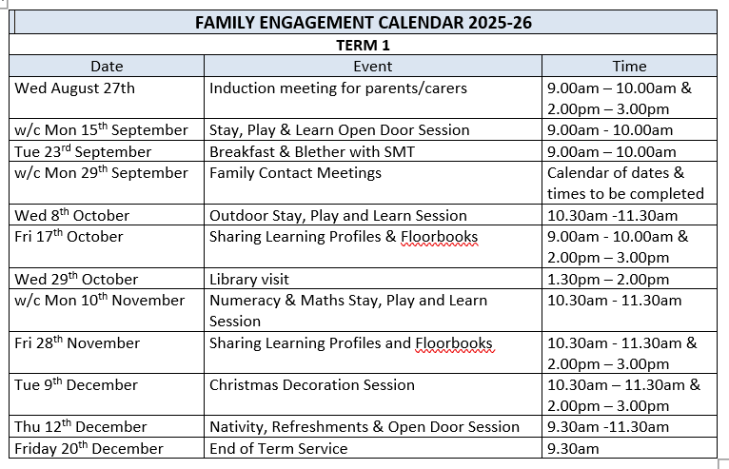
Family Engagement Calendar
Family Engagement Calendar

Slide 13

Family Learning
Bumps to Bairns - https://bumps2bairns.com/
Peep sessions
https://www.peeple.org.uk/ltp
Bookbug - https://www.scottishbooktrust.com/bookbug
Play Scotland - https://www.playscotland.org/parents-families/
Parentzone Scotland - https://education.gov.scot/parentzone/

Slide 14
Further reading…
Family Engagement – Early Learning and Childcare in Highland (elchighland.com)
Me, my family and my childcare setting
Connecting with your childcare setting - a guide for families
Engaging parents and families: a toolkit for practitioners

Slide 15
Transitions
“Quality transitions that are well prepared and child-centred, managed by trained staff collaborating with each other, and guided by an appropriate curriculum, enhance the likelihood that the positive impacts of early learning and childcare will last through primary school and beyond”
(OECD, 2017:19)

Slide 16
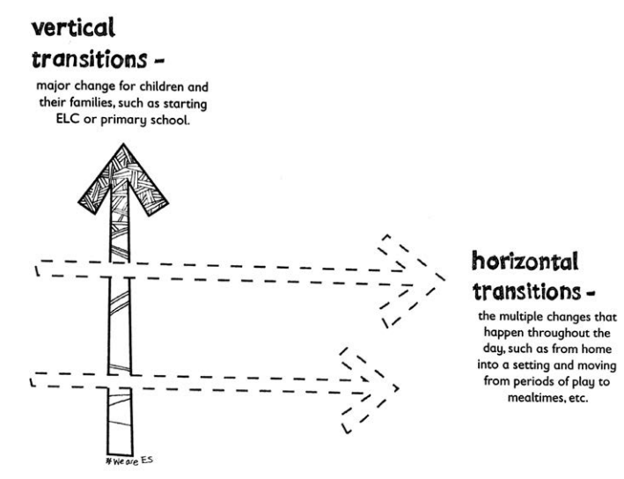
Vertical and horizontal transitions

Slide 17
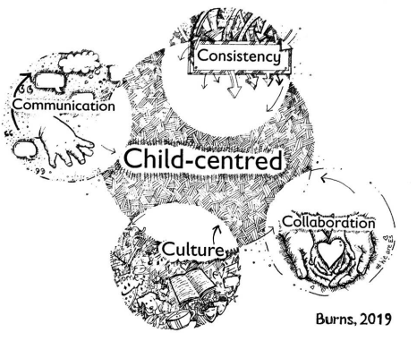
The 5 Cs that contribute to a positive transition

Slide 18
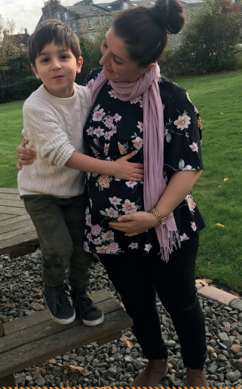
Transitions from home to ELC
Parents can expect to stay and help settle their child.
Effective 2-way communication with families.
Flexible routines which allow siblings to see each other.
Practitioners who encourage the bringing of transitional objects.

Slide 19

Some ideas to support transitions from home to ELC
Child and family friendly invitations to welcome sessions.
Welcome sessions to the ELC setting when families and children can meet their key worker
A virtual tour of ELC for children and their families.
Story sacks shared between ELC and home in the months preceding the child starting in the setting.

Slide 20
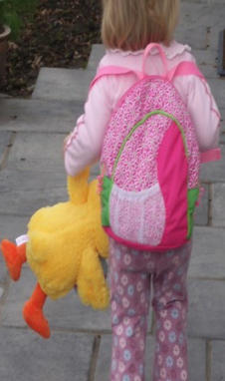
Positive transitions from ELC to school need practitioners who recognise that for every child the transition experience is unique to them and who provide environments that are ready for children, that meet their needs and the needs of their family. Realising the Ambition P95
Transitions from ELC to school

Slide 21
Planning for the transition from ELC to school
A year long process – at least!
Regular and varied opportunities – Transitions Calendar
Collaboration between ELC practitioners and P1 teachers
Share information about the child’s learning and development
Build on what a child already knows and can do
Value the parents’ knowledge of their child

Slide 22
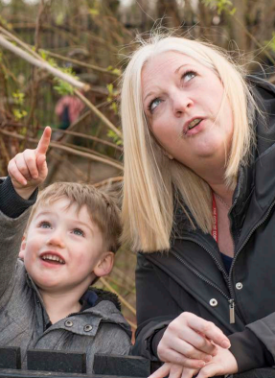
Some ideas to support transitions from ELC to school
Regular visits to the P1 class, particularly for children in
their pre-school year
Regular visits by the P1 teacher to the ELC setting
Regular visits to the school library
Participation in assemblies when appropriate
Shared experiences with the P1
Involvement in school events when appropriate, such as
Christmas Concerts
Play visits or reading buddy visits from P6 buddies
Canteen visits
Shared playtimes

Slide 23
Transitions between partner settings, childminders and local authority settings
Regular opportunities to visit settings where a child will be transitioning to.
Visits from key workers, teachers and/or the SMT.
Invitations to events, such as Christmas concerts and Sports Day.
Arranging shared experiences, such as a visit to the play park or a Woods Day.

Slide 24
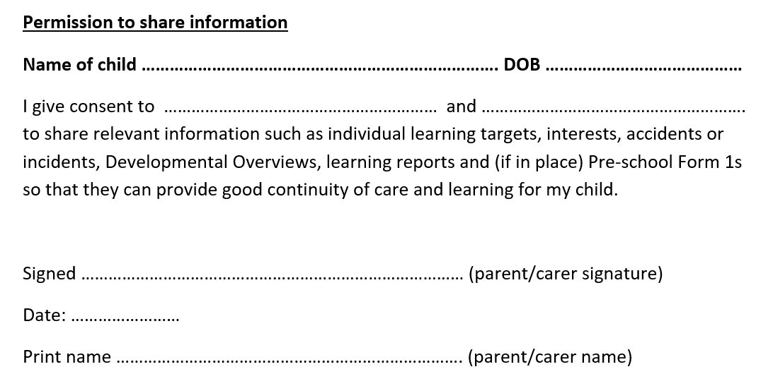
Blended Placement Transitions
Regular contact between ELC settings attended by the child to support continuity
Working together to meet the needs of the child and their family
Blended Placement Guidance for ELC

Slide 25
Key feature of horizonal transitions
“Practitioners who are responsive to the small transitions that occur throughout the day; nappy changing, mealtimes, moving between rooms and adjusting emotionally in response to changes of practitioners working on shift patterns.”
Realising the Ambition

Slide 26

Enhanced transitions
Extra visits to the school
My Photo/Video book: Personalised for the child to show staff/names, activities, and areas they will access (e.g. toilets, playground, canteen/gym hall, sensory room, breakout space, etc.)
Share any communication supports used at home (e.g gestures/ Makaton/ objects, photos/symbols) and any advice given.
Favourite Toys: Provide a selection of toys and activities which the child enjoys.
Transition Object: Take a favourite toy or activity between ELC/home and school to ease the transition.
https://highlandcouncilpsychologicalservice.store/home/practitioner/play-and-learning-resources-for-asn/easeys-for-asn/transitions/
Autism Toolbox
Home | Autism Toolbox Autism Toolbox

Slide 27
There is an emphasis on the need for strong leadership and a shared understanding of strengths and areas for development. The impact of self-evaluation and quality assurance leads to improved and sustained positive outcomes for children and families
Quality Improvement Framework September 2025

Slide 28
Resources
Realising the Ambition - Being Me Section 8 Transitions matter
elc-practice-note-2-transitions.pdf - Keeping children safe: supporting transitions in ELC
https://www.strath.ac.uk/media/faculties/hass/education/transitions_statement.pdf
Scottish Early Childhood. Children and Families Transition Position Statement

Slide 29

Any questions?

