Slide 1

Quality Observation in ELC
6th October 2025

Slide 2
Aims
Why we observe in ELC
How we achieve high quality learning observations
What high quality observations look like
How to monitor observations
How to use monitoring evidence

Slide 3
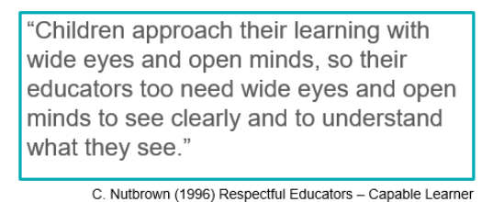

Slide 4

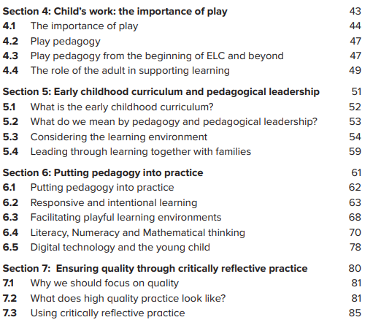
Supporting Quality

Slide 5
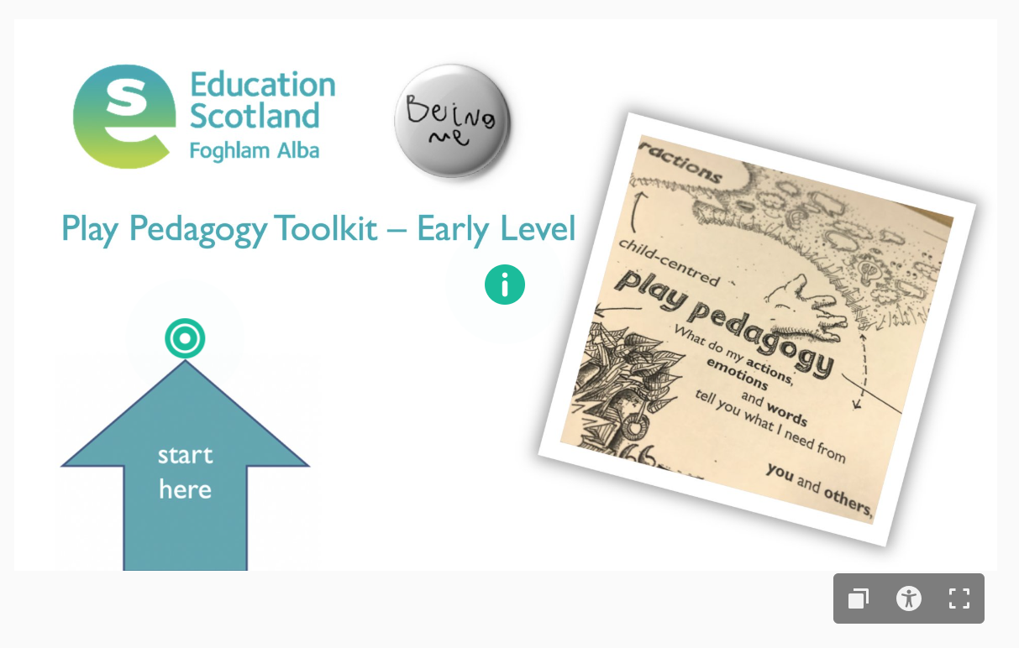

Supporting Quality
https://education.gov.scot/resources/early-level-play-pedagogy-toolkit/

Slide 6

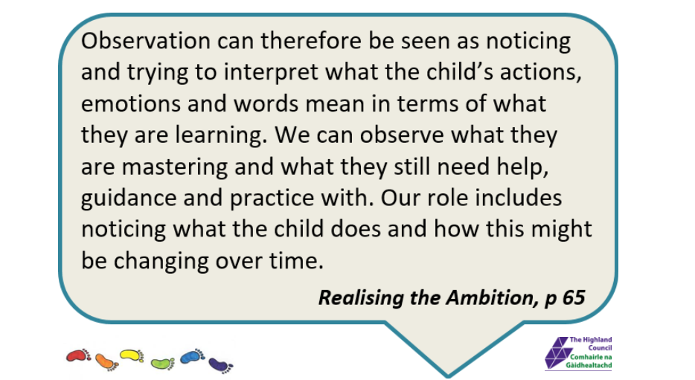

Learning, Teaching and Assessment.
This indicator highlights the importance of observing and interacting sensitively with children to plan and assess their learning.
This quality indicator emphasises the importance of robust tracking and monitoring of children’s progress to ensure staff know all children very well as learners. A quality improvement framework for the early learning and childcare sectors:
Observations are central to assessment and inform us what children need.”
(Realising the Ambition, Education Scotland, 2020, p. 46)

Slide 7
Why observe?
To gain knowledge of what a child knows, understands and can currently do
To understand a child’s strengths and interests
To understand how and where the child learns best
To understand the child’s stage of development
To provide opportunities to move learning forwards

Slide 8

Observation
The key to quality learning and play pedagogy
A young child’s voice is interpreted by our observations of their actions, emotions and words. These observations are central to assessment and inform us of what children need. “What do the children’s actions, emotions and words tell you about what they require from you and others [their interactions], their experiences, and the different spaces they need to grow and develop in every way?” Enabling play pedagogy is a skilful job.
Realising the Ambition Page 46

Slide 9



How do we support quality observation?

Slide 10
Observation
Describe what is noteworthy
Analyse
Improve
Observation Cycle

Slide 11
Observation
Describe what is noteworthy
Analyse
Improve
What did I notice? (see/hear)
Observation Cycle

Slide 12
Observation
Describe what is noteworthy
Analyse
Improve
What did I notice? (see/hear)
Observation Cycle
What does this tell me/what does this mean?
(see/hear)

Slide 13
Observation
Describe what is noteworthy
Analyse
Improve
What did I notice? (see/hear)
Observation Cycle
What will I do now?
What does this tell me/what does this mean?
(see/hear)

Slide 14
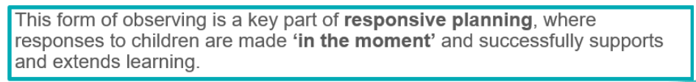
Not all observations are recorded

Slide 15
Why are quality observations important?
High-quality observations should capture the important, meaningful details of a child’s learning and give significant insight into their development, learning and progress over time.
Through observation, practitioners should identify possible ways to take the child deeper in their learning, not just onwards and upwards, but also identifying ways to consolidate, widen, and revisit the learning

Slide 16
How do I monitor that?
Have a robust monitoring calendar in place that includes termly quality assurance of children’s profiles and learning observations
Sample profiles and learning observations from all key workers across the staff team
Sample profiles and learning observations from across age groups within your setting
Use the template available to quality assure learning observations within the learning profiles

Slide 17
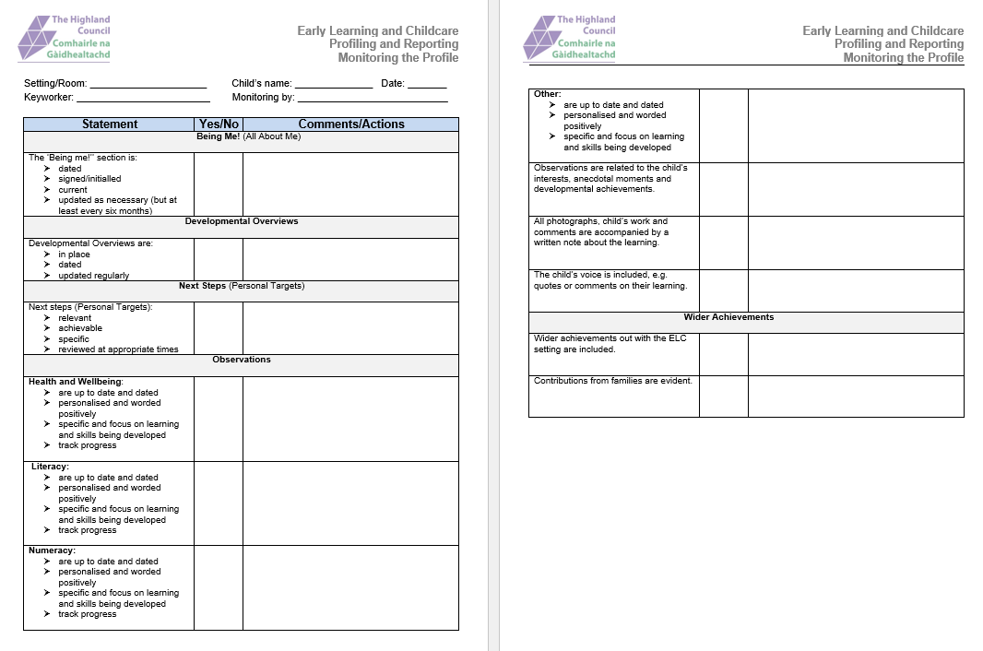
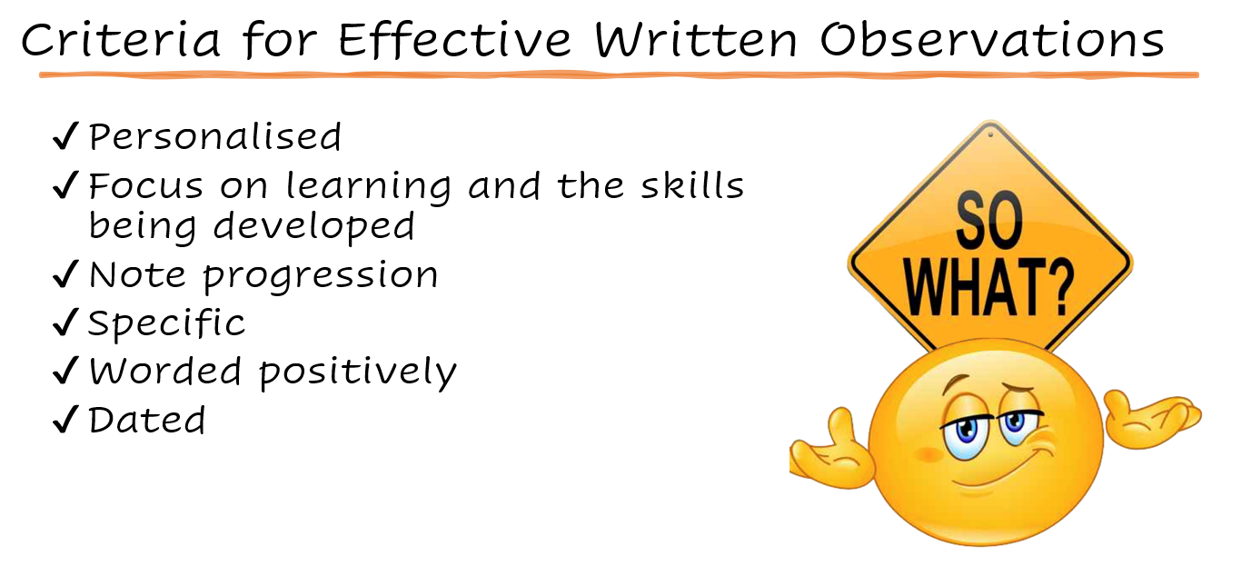
Monitoring Template
https://elchighland.com/profiling-and-reporting/

Slide 18
What should I see?
Observations should be dated and added regularly to all children’s profiles
Observations should be personalised and specific to the child
Observations should be undertaken by all practitioners, with keyworkers responsible for collating this information for their key children
Children’s profiles should have a significant number of observations across curricular areas to show where they are in their learning
Observations should note significant learning and any photographs and children’s words included should be relevant to the learning

Slide 19
What am I looking for – Digging Deeper?
Observations of significant learning experiences are relevant to the age and developmental stage of the child
Individual profiles should have enough high-quality observations to show a child’s progress and development over time. This progress is clear, and the practitioner has shown an understanding of Early Level
Observations should be regular and show breadth across curricular areas and evidence high quality learning experiences and interactions that engaging and relevant
Observations should be learning focussed using the language of learning
Observations should have enough factual information about what was seen and heard to provide confidence in planning the child’s next steps in learning.

Slide 20
What does it tell me?
How well practitioners know and understand the Early Level Curriculum
How well children are learning and progressing both individually and as a cohort
How knowledgeable practitioners are about the children in the setting
The quality of spaces, experiences and interactions on offer in your setting

Slide 21
What now?
Provide feedback to staff on what you have noticed
Identify and provide any training needs
Use the information to track progress
Use as part of self-evaluation, improvement and change
Consult the Early Years Team for any additional advice/support

Slide 22
“Play is often talked about as if it were a relief from serious learning. But for children, play is serious learning.“
Fred Rogers

Slide 23

Thank you
Helpful links
Play Pedagogy Toolkit - https://education.gov.scot/resources/early-level-play-pedagogy-toolkit/
Realising the Ambition - https://education.gov.scot/media/3bjpr3wa/realisingtheambition.pdf
Quality Improvement Framework – https://education.gov.scot/inspection-and-review/inspection-frameworks/quality-improvement-framework-for-the-early-learning-and-childcare-sectors/
Highland ELC blog – Observations - https://elchighland.com/profiling-and-reporting/

